Slide 1

Spatiotemporal models of juvenile coho salmon densities in the Siletz River watershed
Dr. Merrill Rudd
Research scientist
Scaleabilty LLC
September 2019

Slide 2
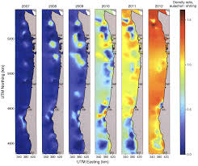
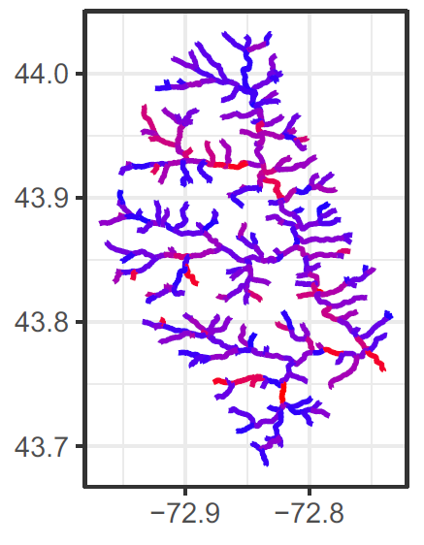
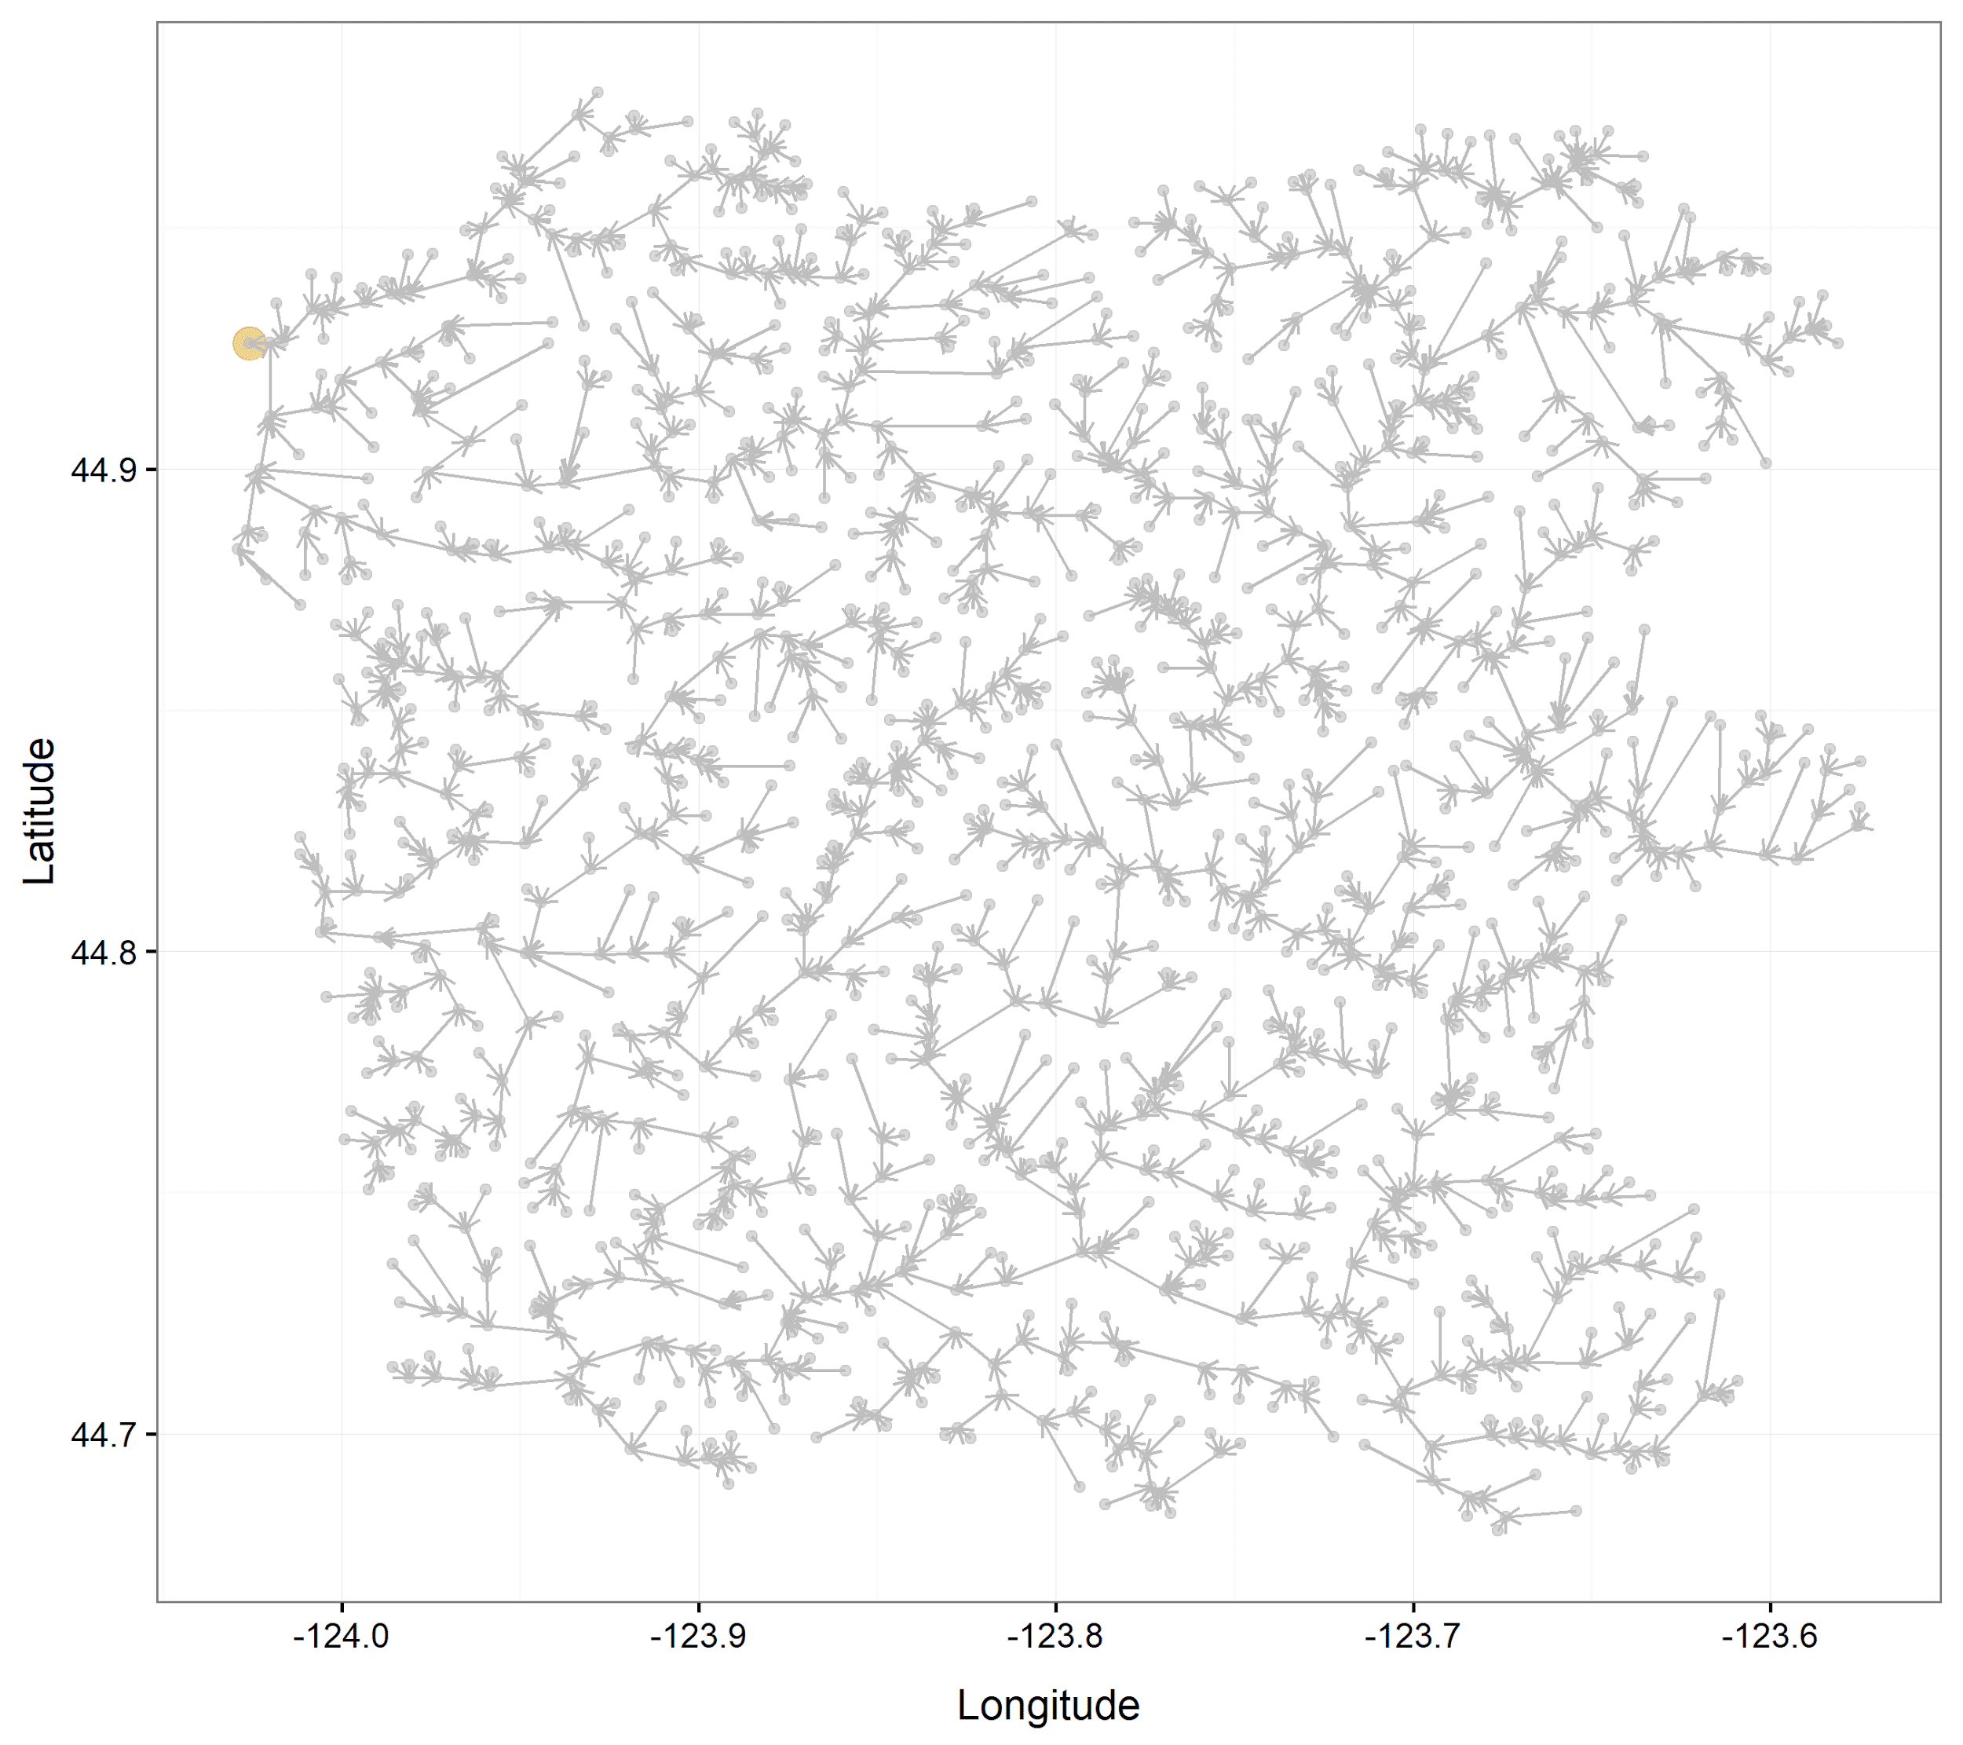
Objective: estimating juvenile coho salmon densities
1) Spatiotemporal effects: why and how?
2) Stream networks: what considerations are necessary?
3) Applications for the Siletz River watershed including impacts from spawner densities and habitat covariates

Slide 3
Why should we consider spatiotemporal effects?
Many ecological processes occur over time and space, often both.
Examples for fisheries:
Stock assessment: catch-per-unit-effort changes from fishing pressure and location of fish.
Habitat assessment: range expansion and contraction.
Climate assessment: distribution shifts.
Ecosystem assessment: Estimate covariation between multiple species, life stages, or other components of an ecosystem.
Juvenile coho salmon densities are likely impacted by stream habitat, spawner densities, and other processes that vary over time and space.
Thorson 2019, Fisheries Research

Slide 4
How can we model spatiotemporal effects?
Spatiotemporal models are “state-space models” which predict at least one response variable and its change over time and space, accounting for process variability and measurement error.
Vector Autoregressive Spatio-Temporal (VAST) R package:
Used to address common questions for stock, habitat, ecosystem, and climate assessments:
Correlated spatiotemporal variation among species (Thorson et al. 2016, Glob. Ecol. Biogeogr.)
Index of abundance for stock assessment (Thorson et al. 2015 ICES JMS)
Standardizing samples of age or size-composition data (Thorson and Haltuch 2018 CJFAS)
Range shift metrics (Thorson et al. 2016 Methods in Ecology and Evolution)
Effective area occupied metric (Thorson et al. 2016 Proceedings of Royal Society B)
Includes many features such as multivariate options, density covariates, catchability covariates, large pool of users, and many more.

Slide 5
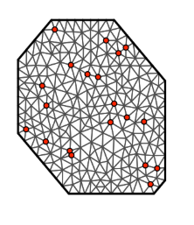
Considerations for modeling a stream network
All applications of VAST use 2D spatial models (until now)
2D mesh assumes that process and/or measurement errors tend to be more similar at nearby sites than geographically distant locations.
However, stream networks are highly correlated over space and time, but two points are not necessarily related by Euclidean distance.
Example mesh
Example stream network
Hocking et al. 2018, Ecological Applications
https://haakonbakka.bitbucket.io/btopic126.html

Slide 6
Considerations for modeling a stream network
Points along a stream network are related based on their physical connectivity, not Euclidean distance.
Many options are available for spatial modeling of stream networks, but do not include spatiotemporal effects.
Spatiotemporal models are an emerging class of statistical models due to increases in computational efficiency
Hocking et al. 2018, Ecological Applications

Slide 7
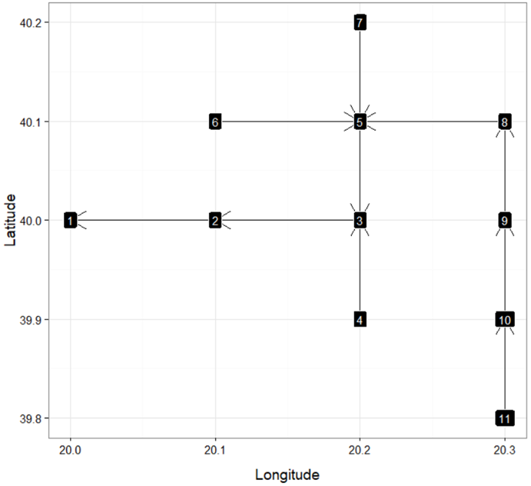
VAST stream network model
Ornstein-Uhlenbeck (OU process)
Models autocorrelation along a network.
Stream segments are defined by a unique upstream (‘child’) node and downstream (‘parent’) node, which may be shared by multiple upstream nodes.
We included the OU process in VAST to take advantage of VAST features and account for stream network autocorrelation.
Hocking et al. 2018, Ecological Applications

Slide 8
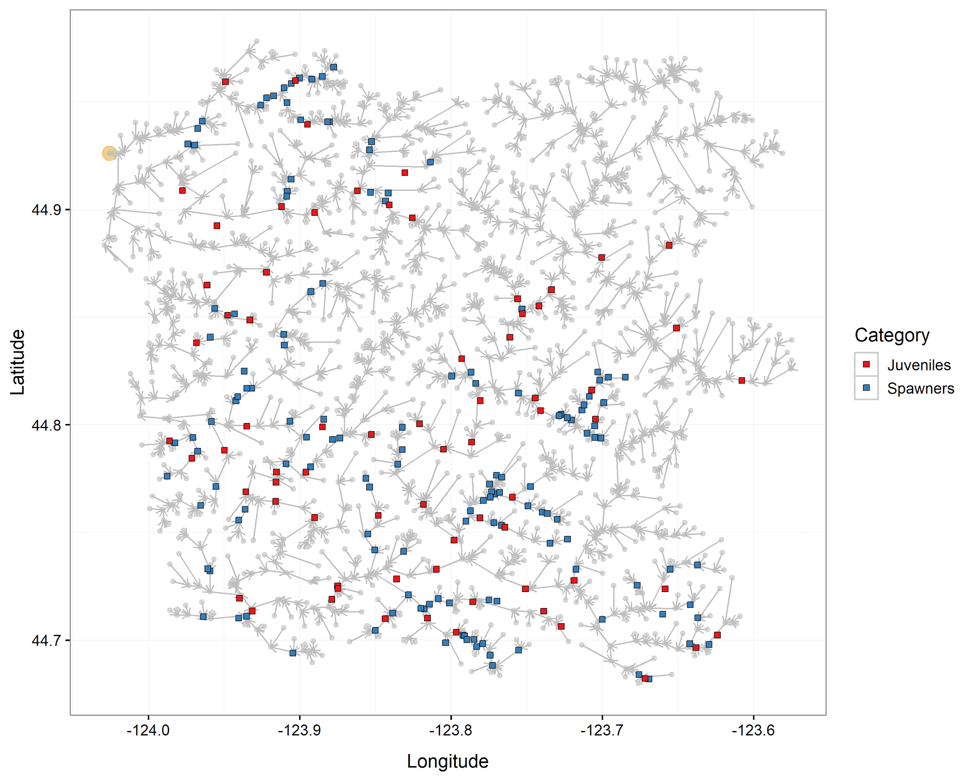
Estimating juvenile coho densities in the Siletz watershed
Oregon Department of Fish and Wildlife provided:
Siletz River watershed stream network(1,571 segments)
Spawner and juvenile surveys: counts and km sampled
Instream habitat survey: monitoring under the Oregon Plan for Salmon and Watersheds (1998 - 2018)
ODFW, Anlauf et al. 2011

Slide 9
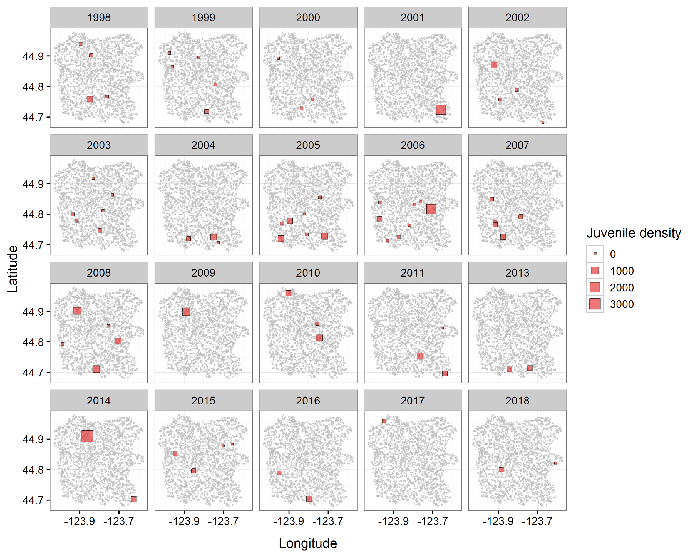
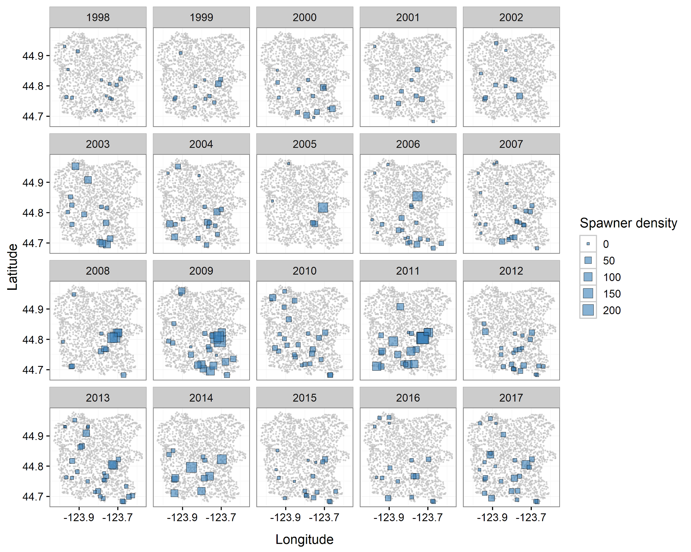
Observed juvenile density
(n=71)
Observed spawner density
(n=347)

Slide 10
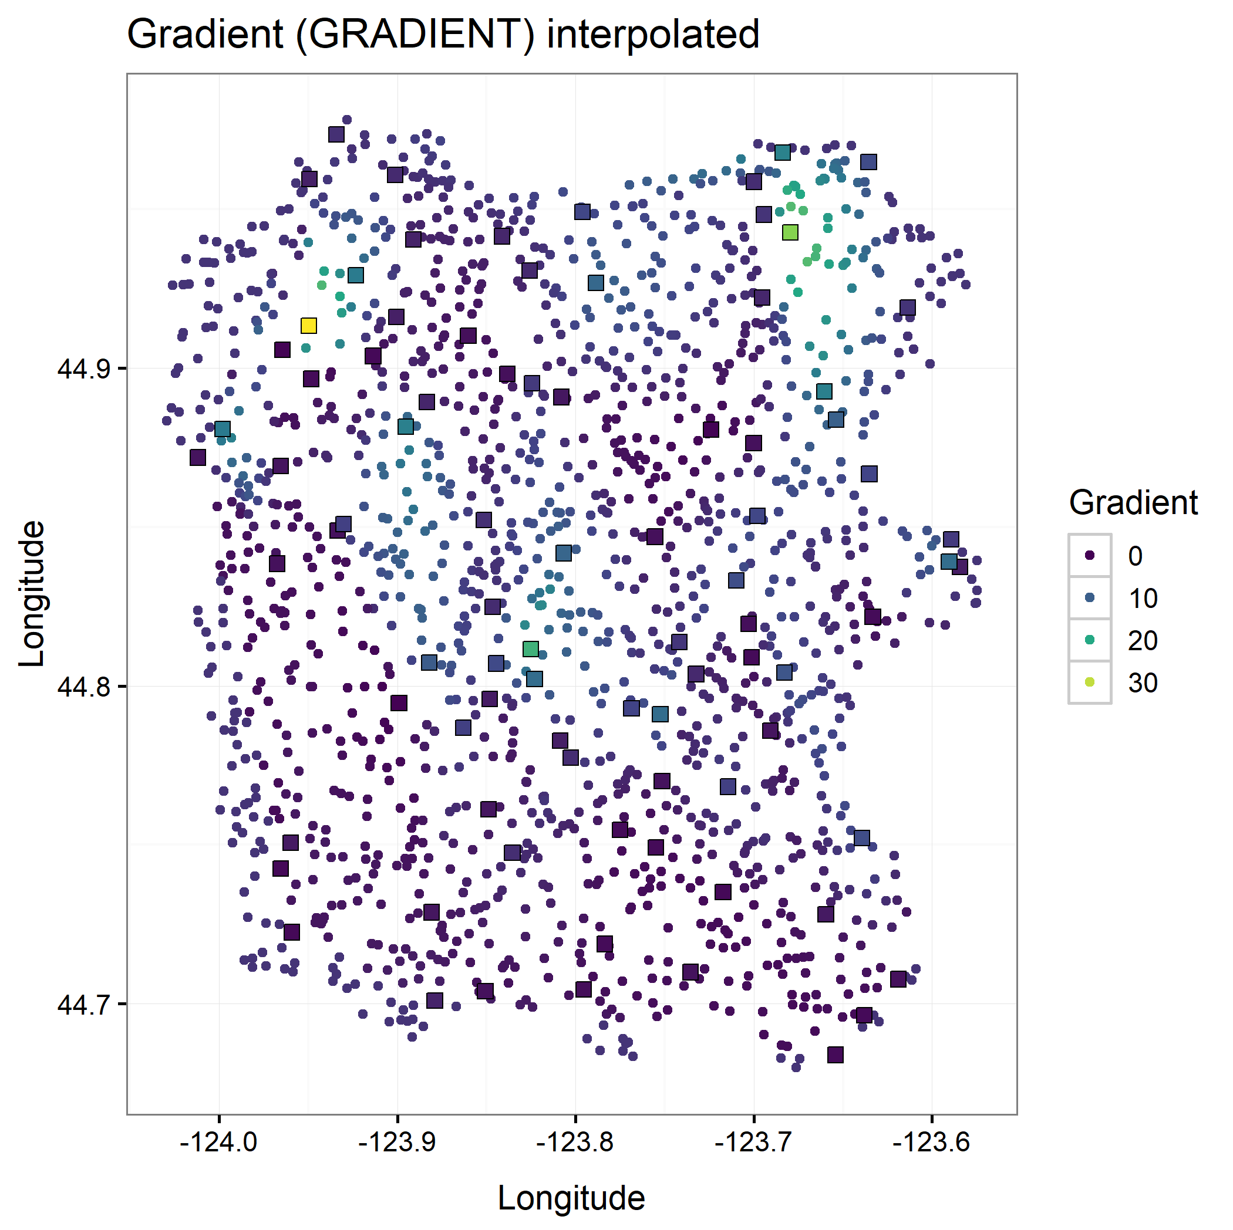
Habitat surveys
Assume habitat information is constant over time
Observations are not available across the entire stream network
Need to interpolate observations - for now just used a simple 2D smoother, which does not account for stream network autocorrelation.

Slide 11
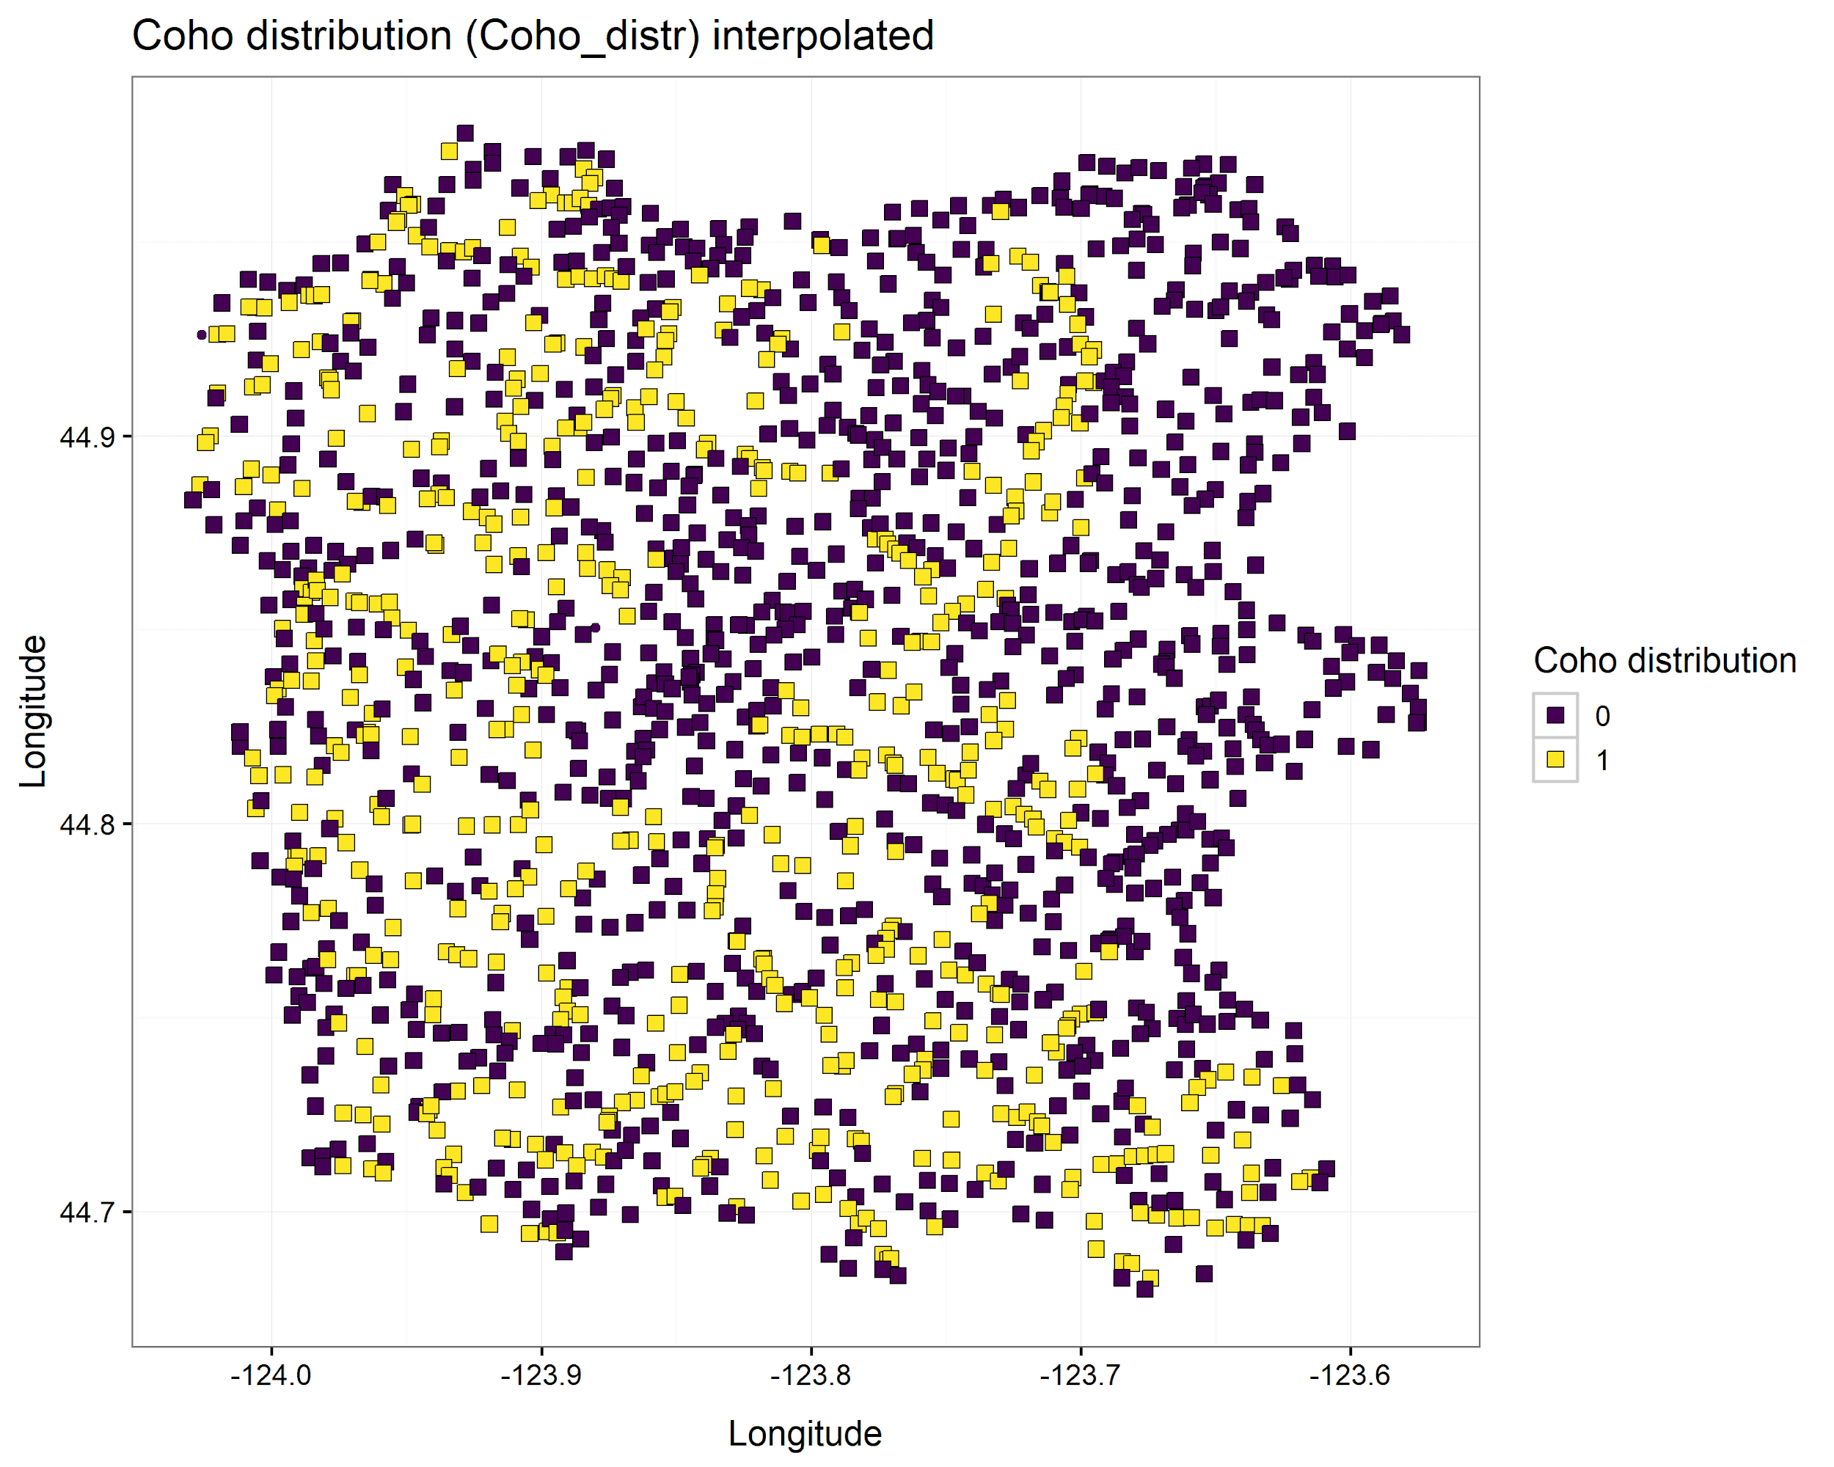

Slide 12
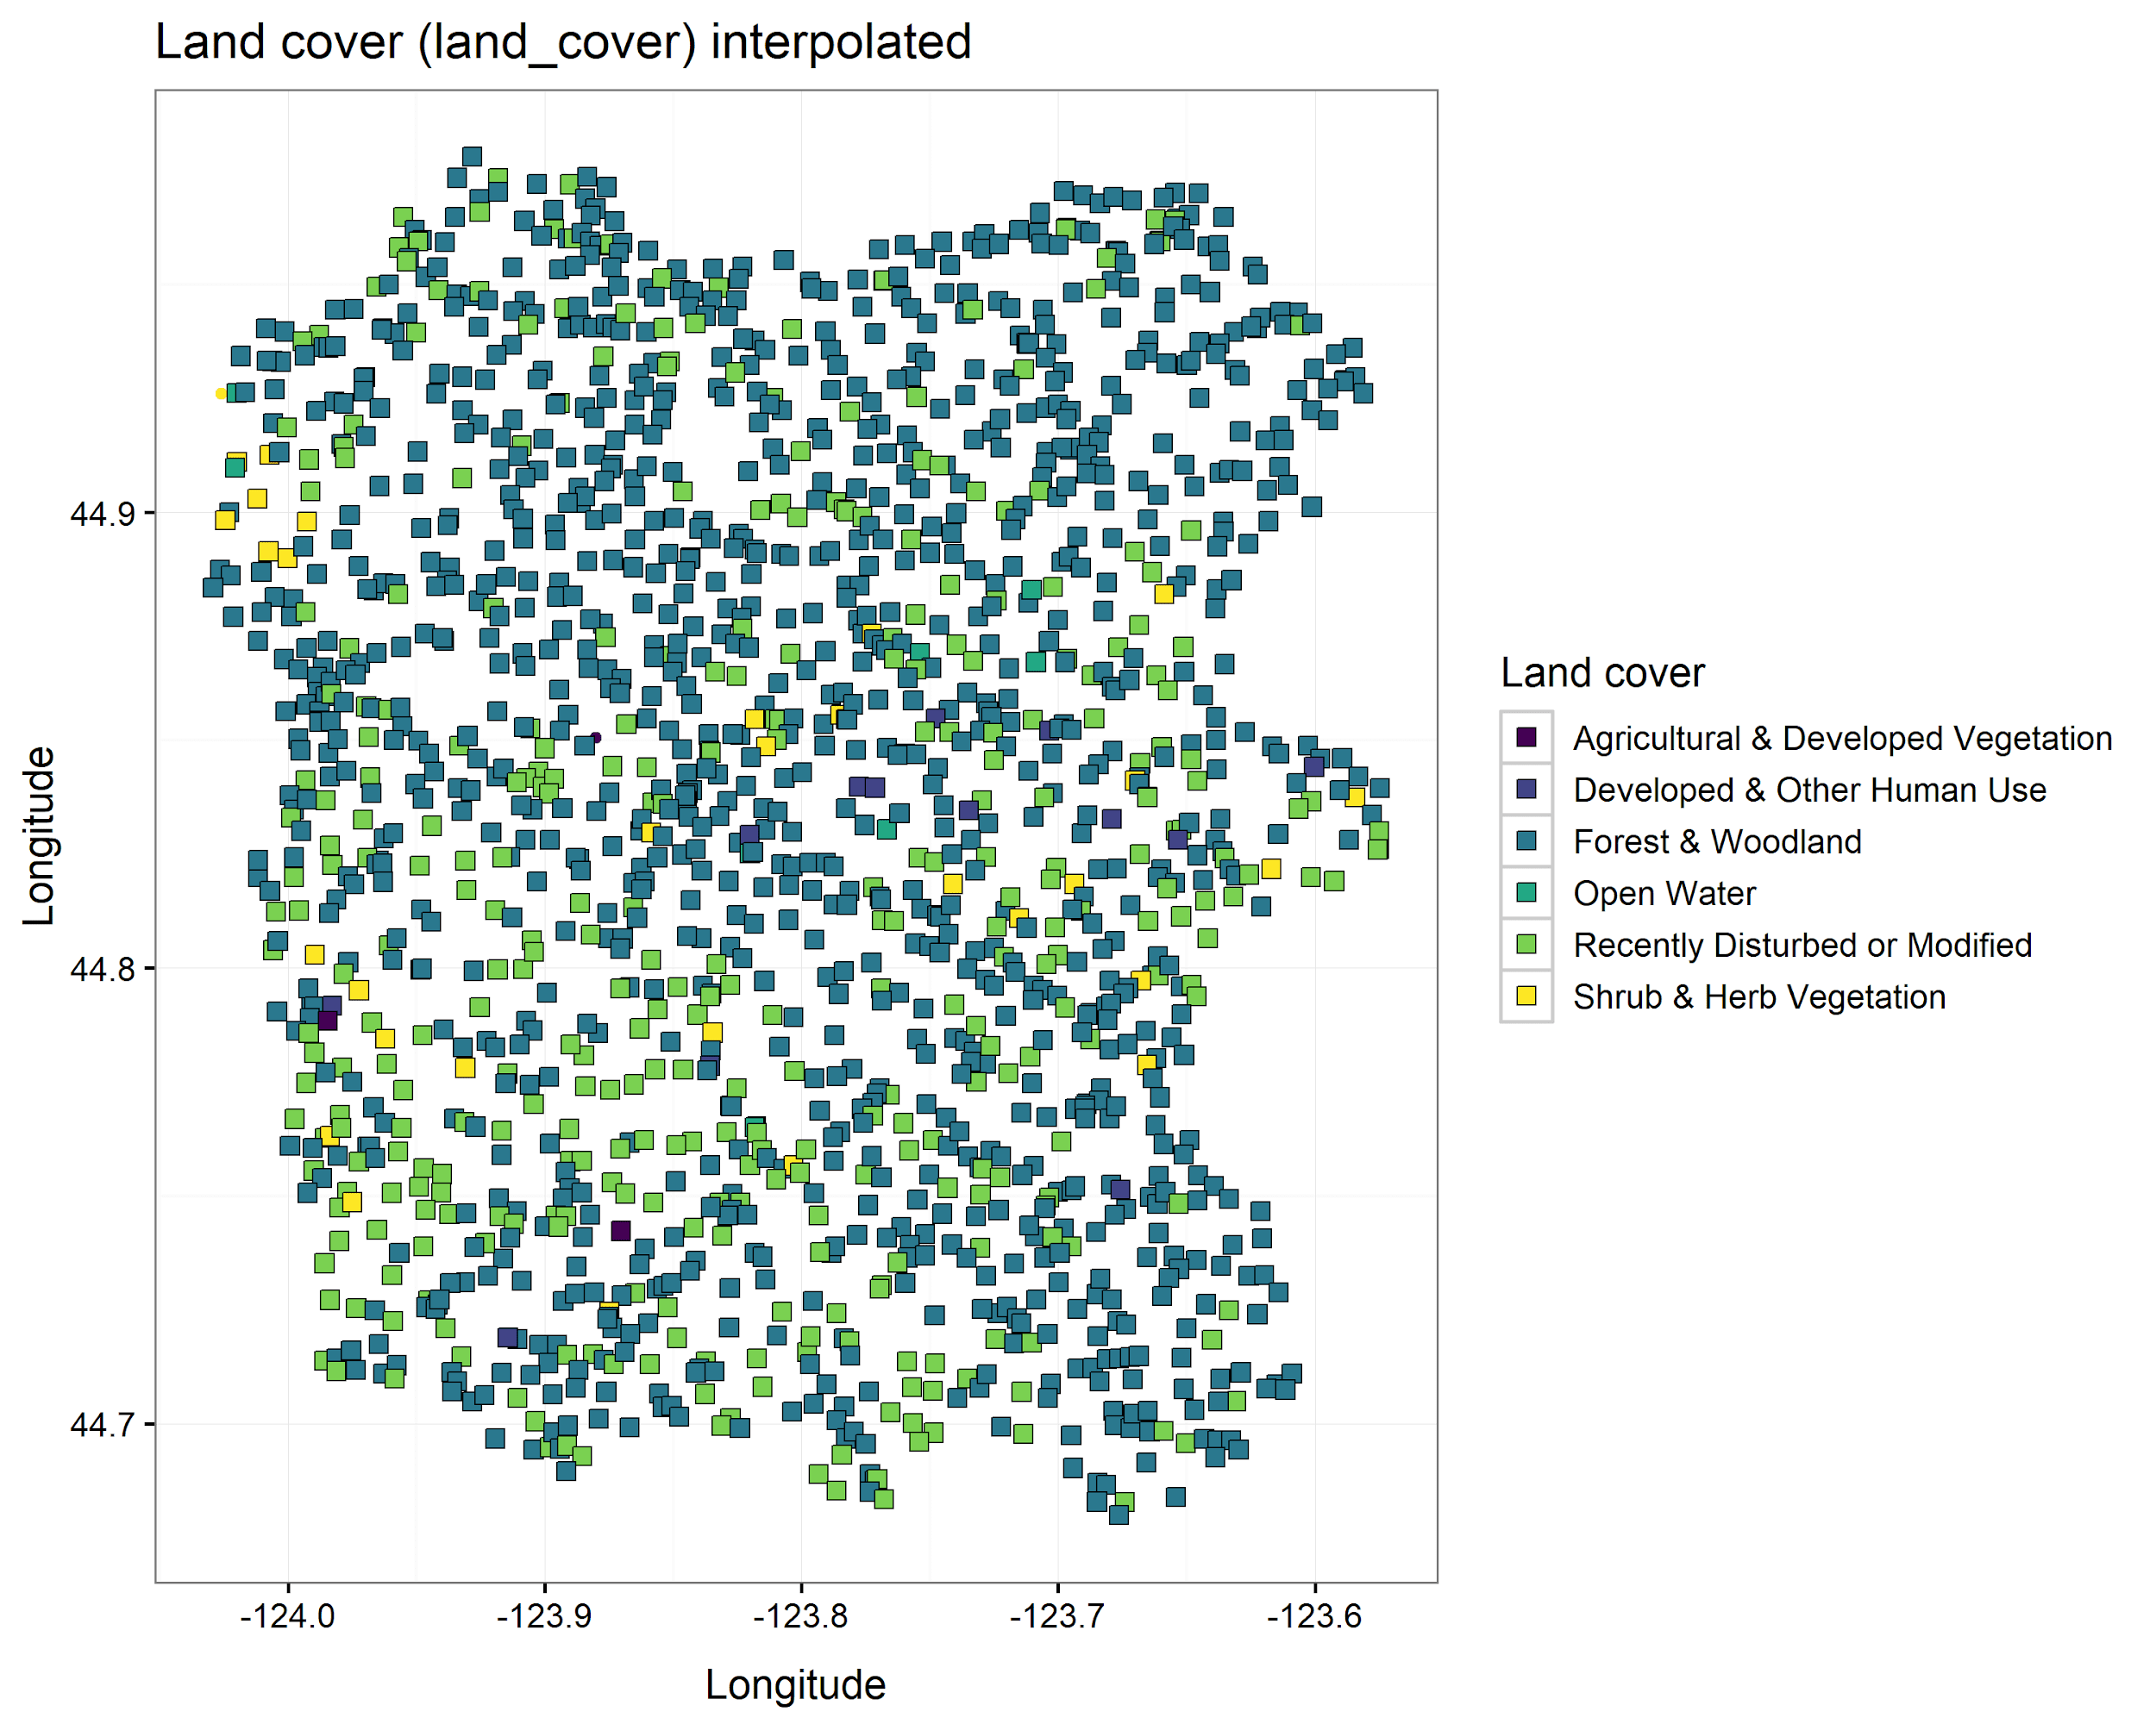

Slide 13
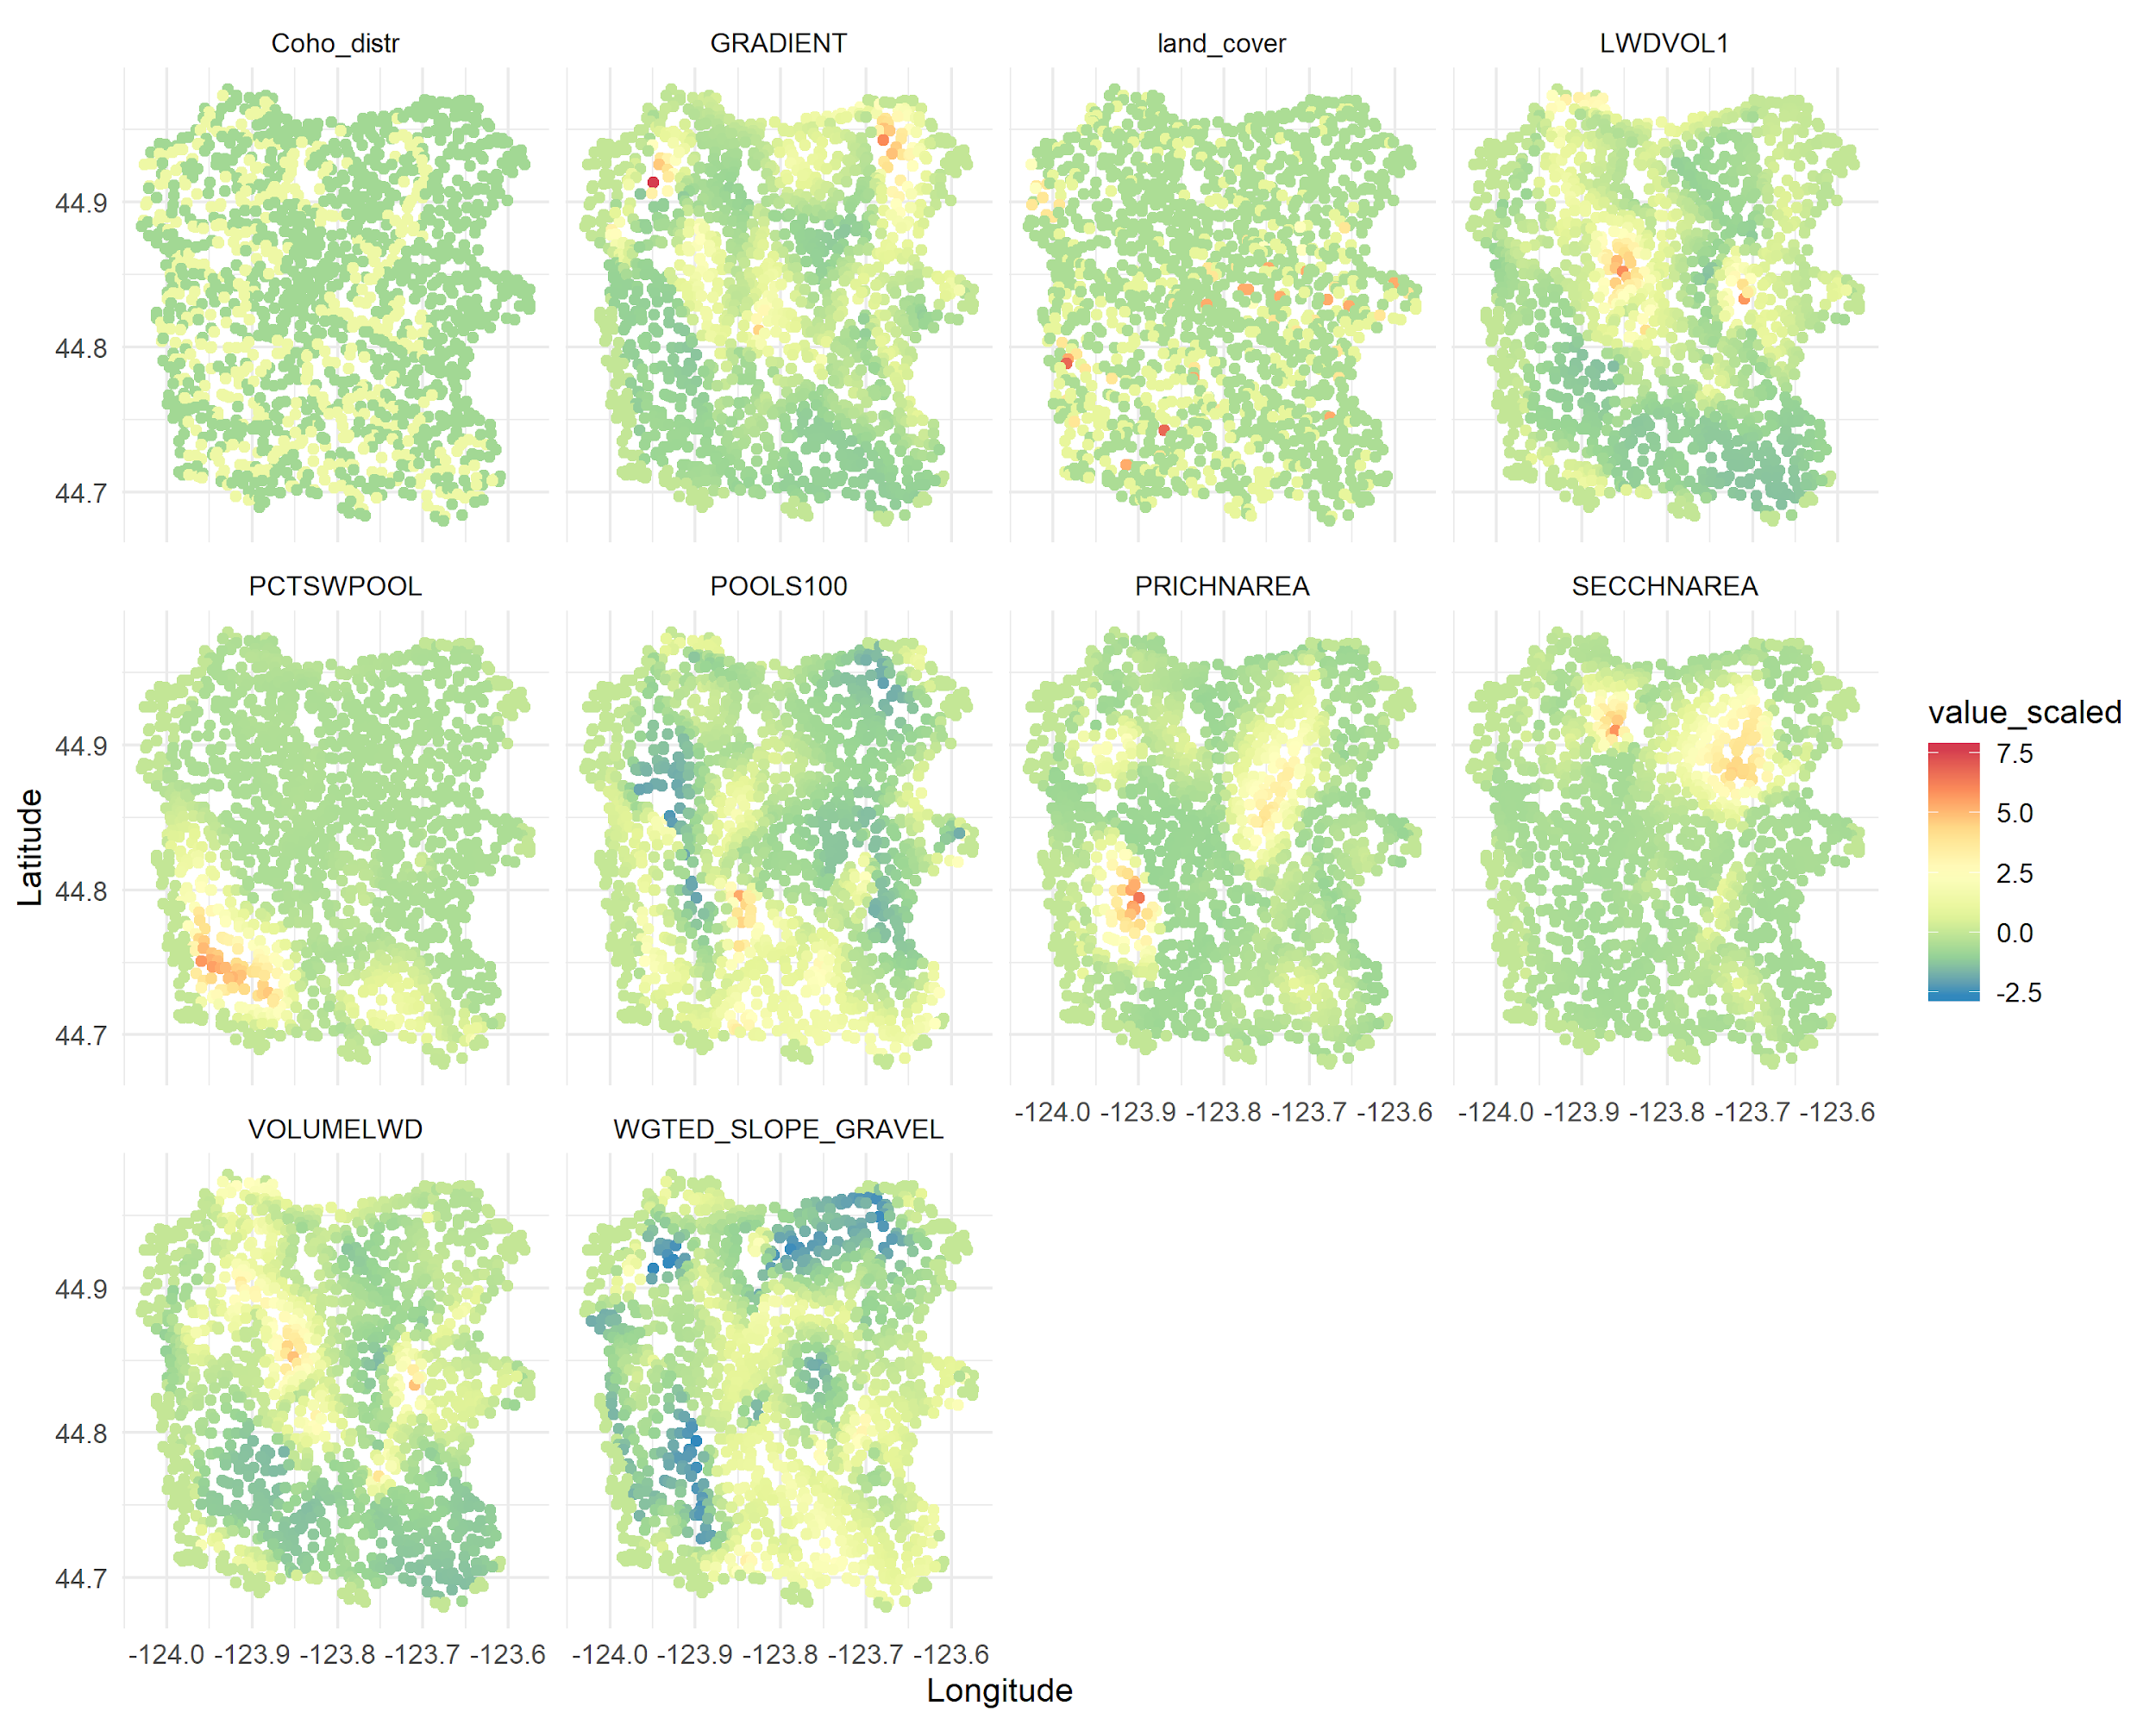
Interpolated habitat covariates
Spawners and juveniles
Juveniles
Spawners
Not used
Anlauf-Dunn, personal communication

Slide 14
Models explored
Zero-inflated lognormal Poisson models
1st linear predictor: Probability that sampling occurs in habitat where species will never occupy (zero-inflated probability)
2nd linear predictor: expected abundance within occupied habitat (abundance-density)
Multivariate models with spawner and juvenile survey count data
compared with univariate model for juveniles
Habitat covariates considering combinations of:
Instream habitat surveys
Land cover information
Coho distribution
Temporal and spatiotemporal smoothers:
Random walk
AR1
Convergence considerations
Zero-inflated probability rarely able to be estimated; spatial and spatio-temporal effects turned off, temporal intercept fixed constant over time
Occasionally need to turn off habitat covariate effects on zero-inflated probability

Slide 15
Multivariate models compared: habitat covariates
Model | Delta AIC | Additional fixed parameters
Habitat survey + coho distribution | 0.00 | Habitat covariate effects on zero-inflated probability
Land cover + coho distribution | 1.01 | None
Coho distribution | 83.5 | Habitat covariate effects on zero-inflated probability; variance for abundance-density for juveniles
Habitat survey | 87.5 | Habitat covariate effects on zero-inflated probability; variance for abundance-density for juveniles
All habitat information | 319.8 | Habitat covariate effects and temporal intercept for zero-inflated probability

Slide 16
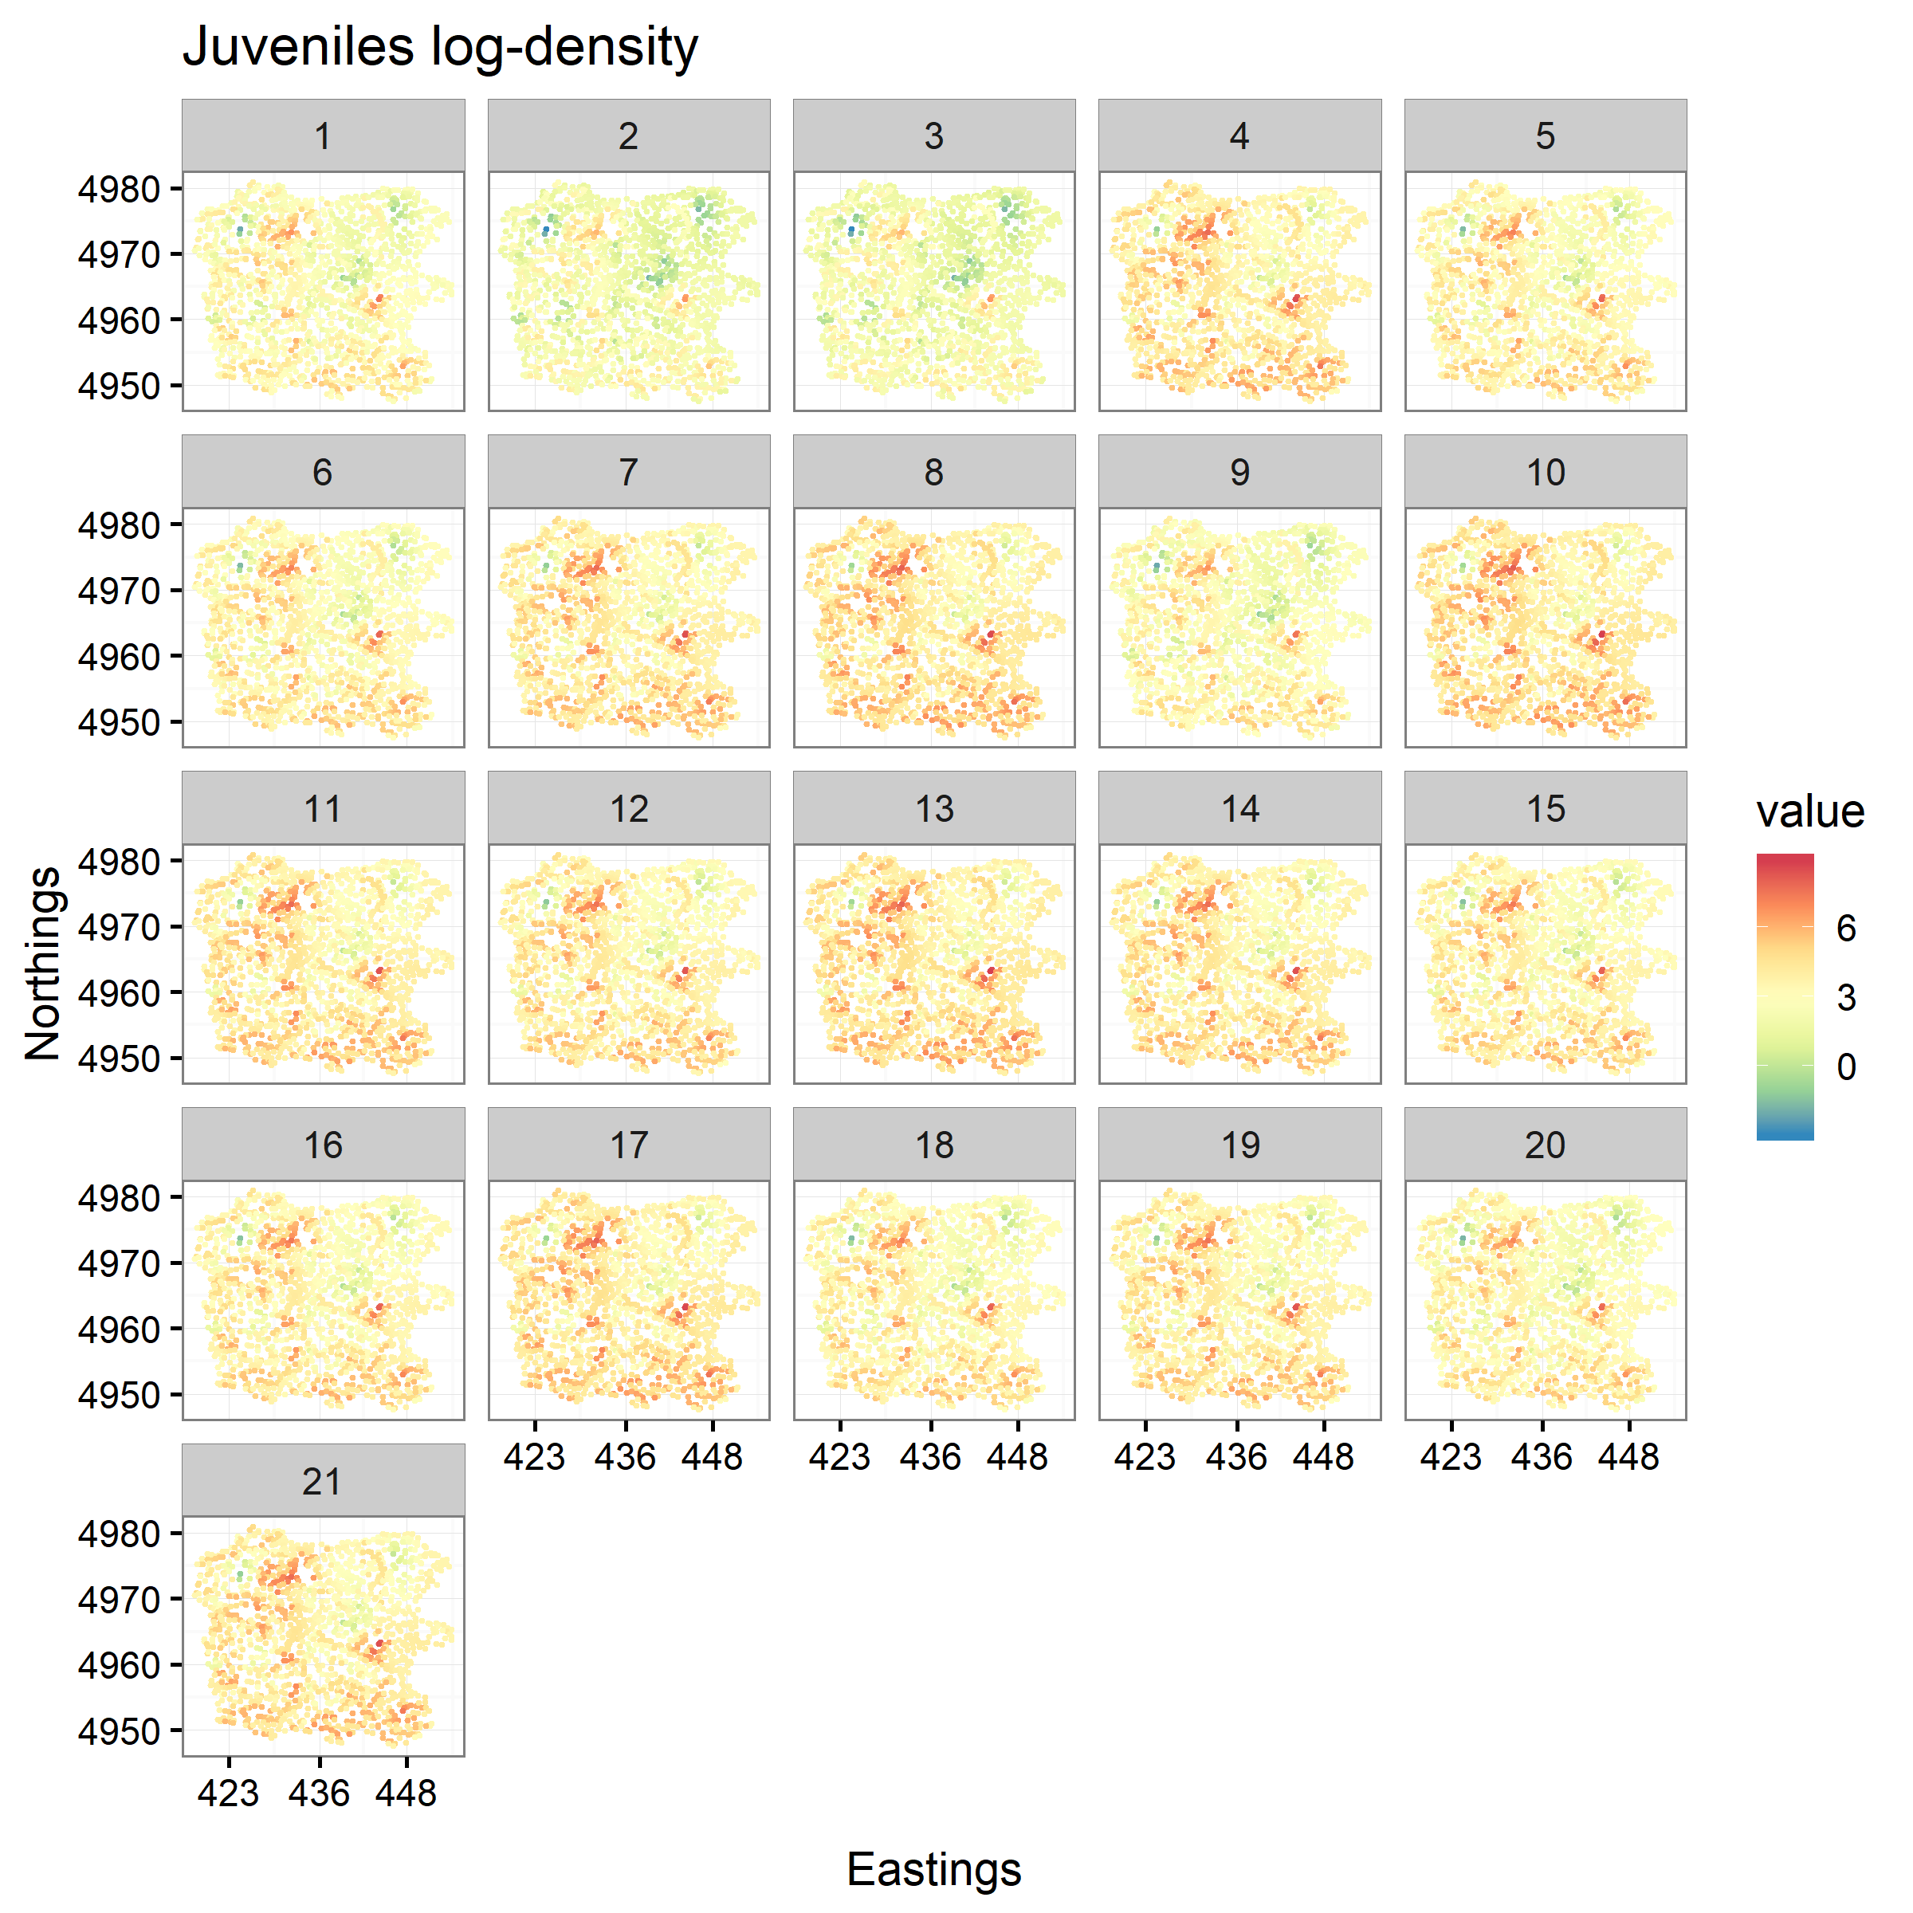
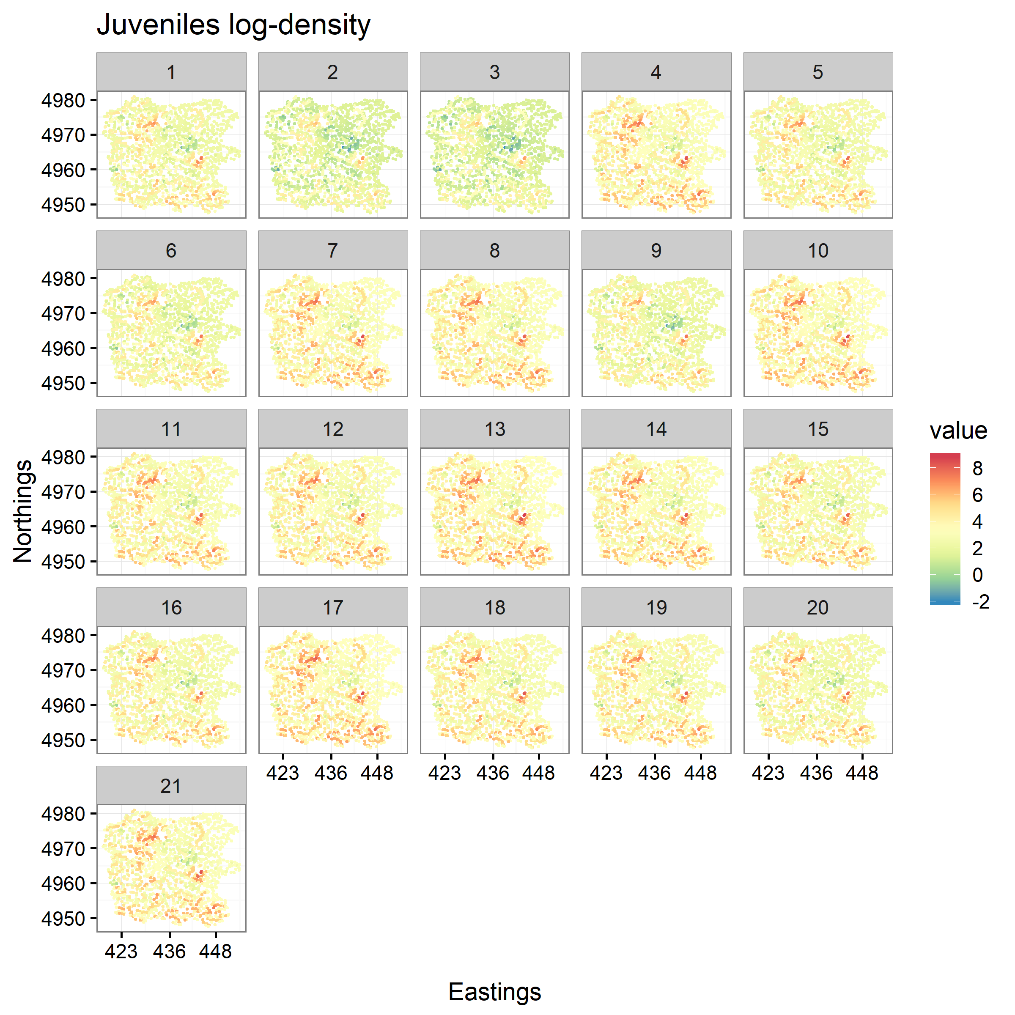
Habitat survey
Land cover categories

Slide 17
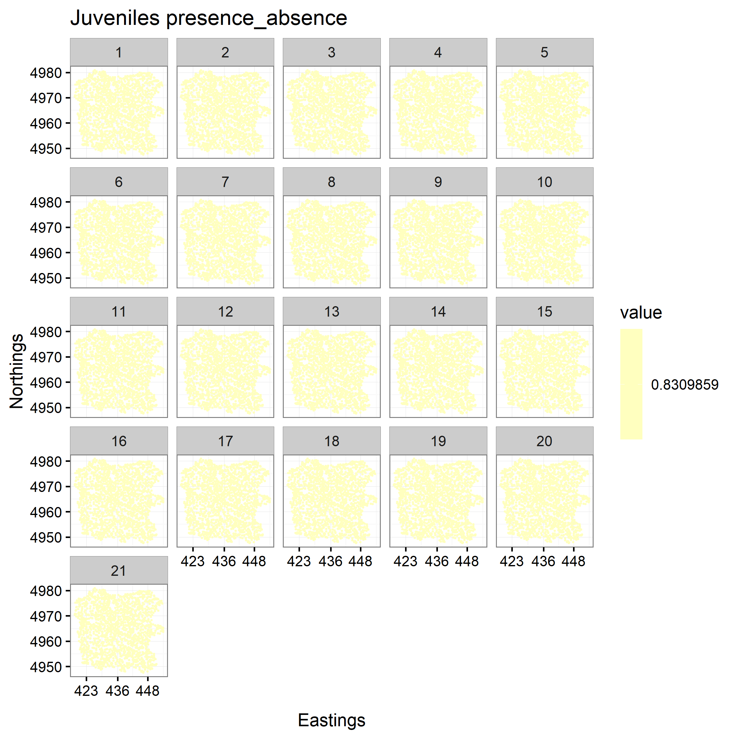
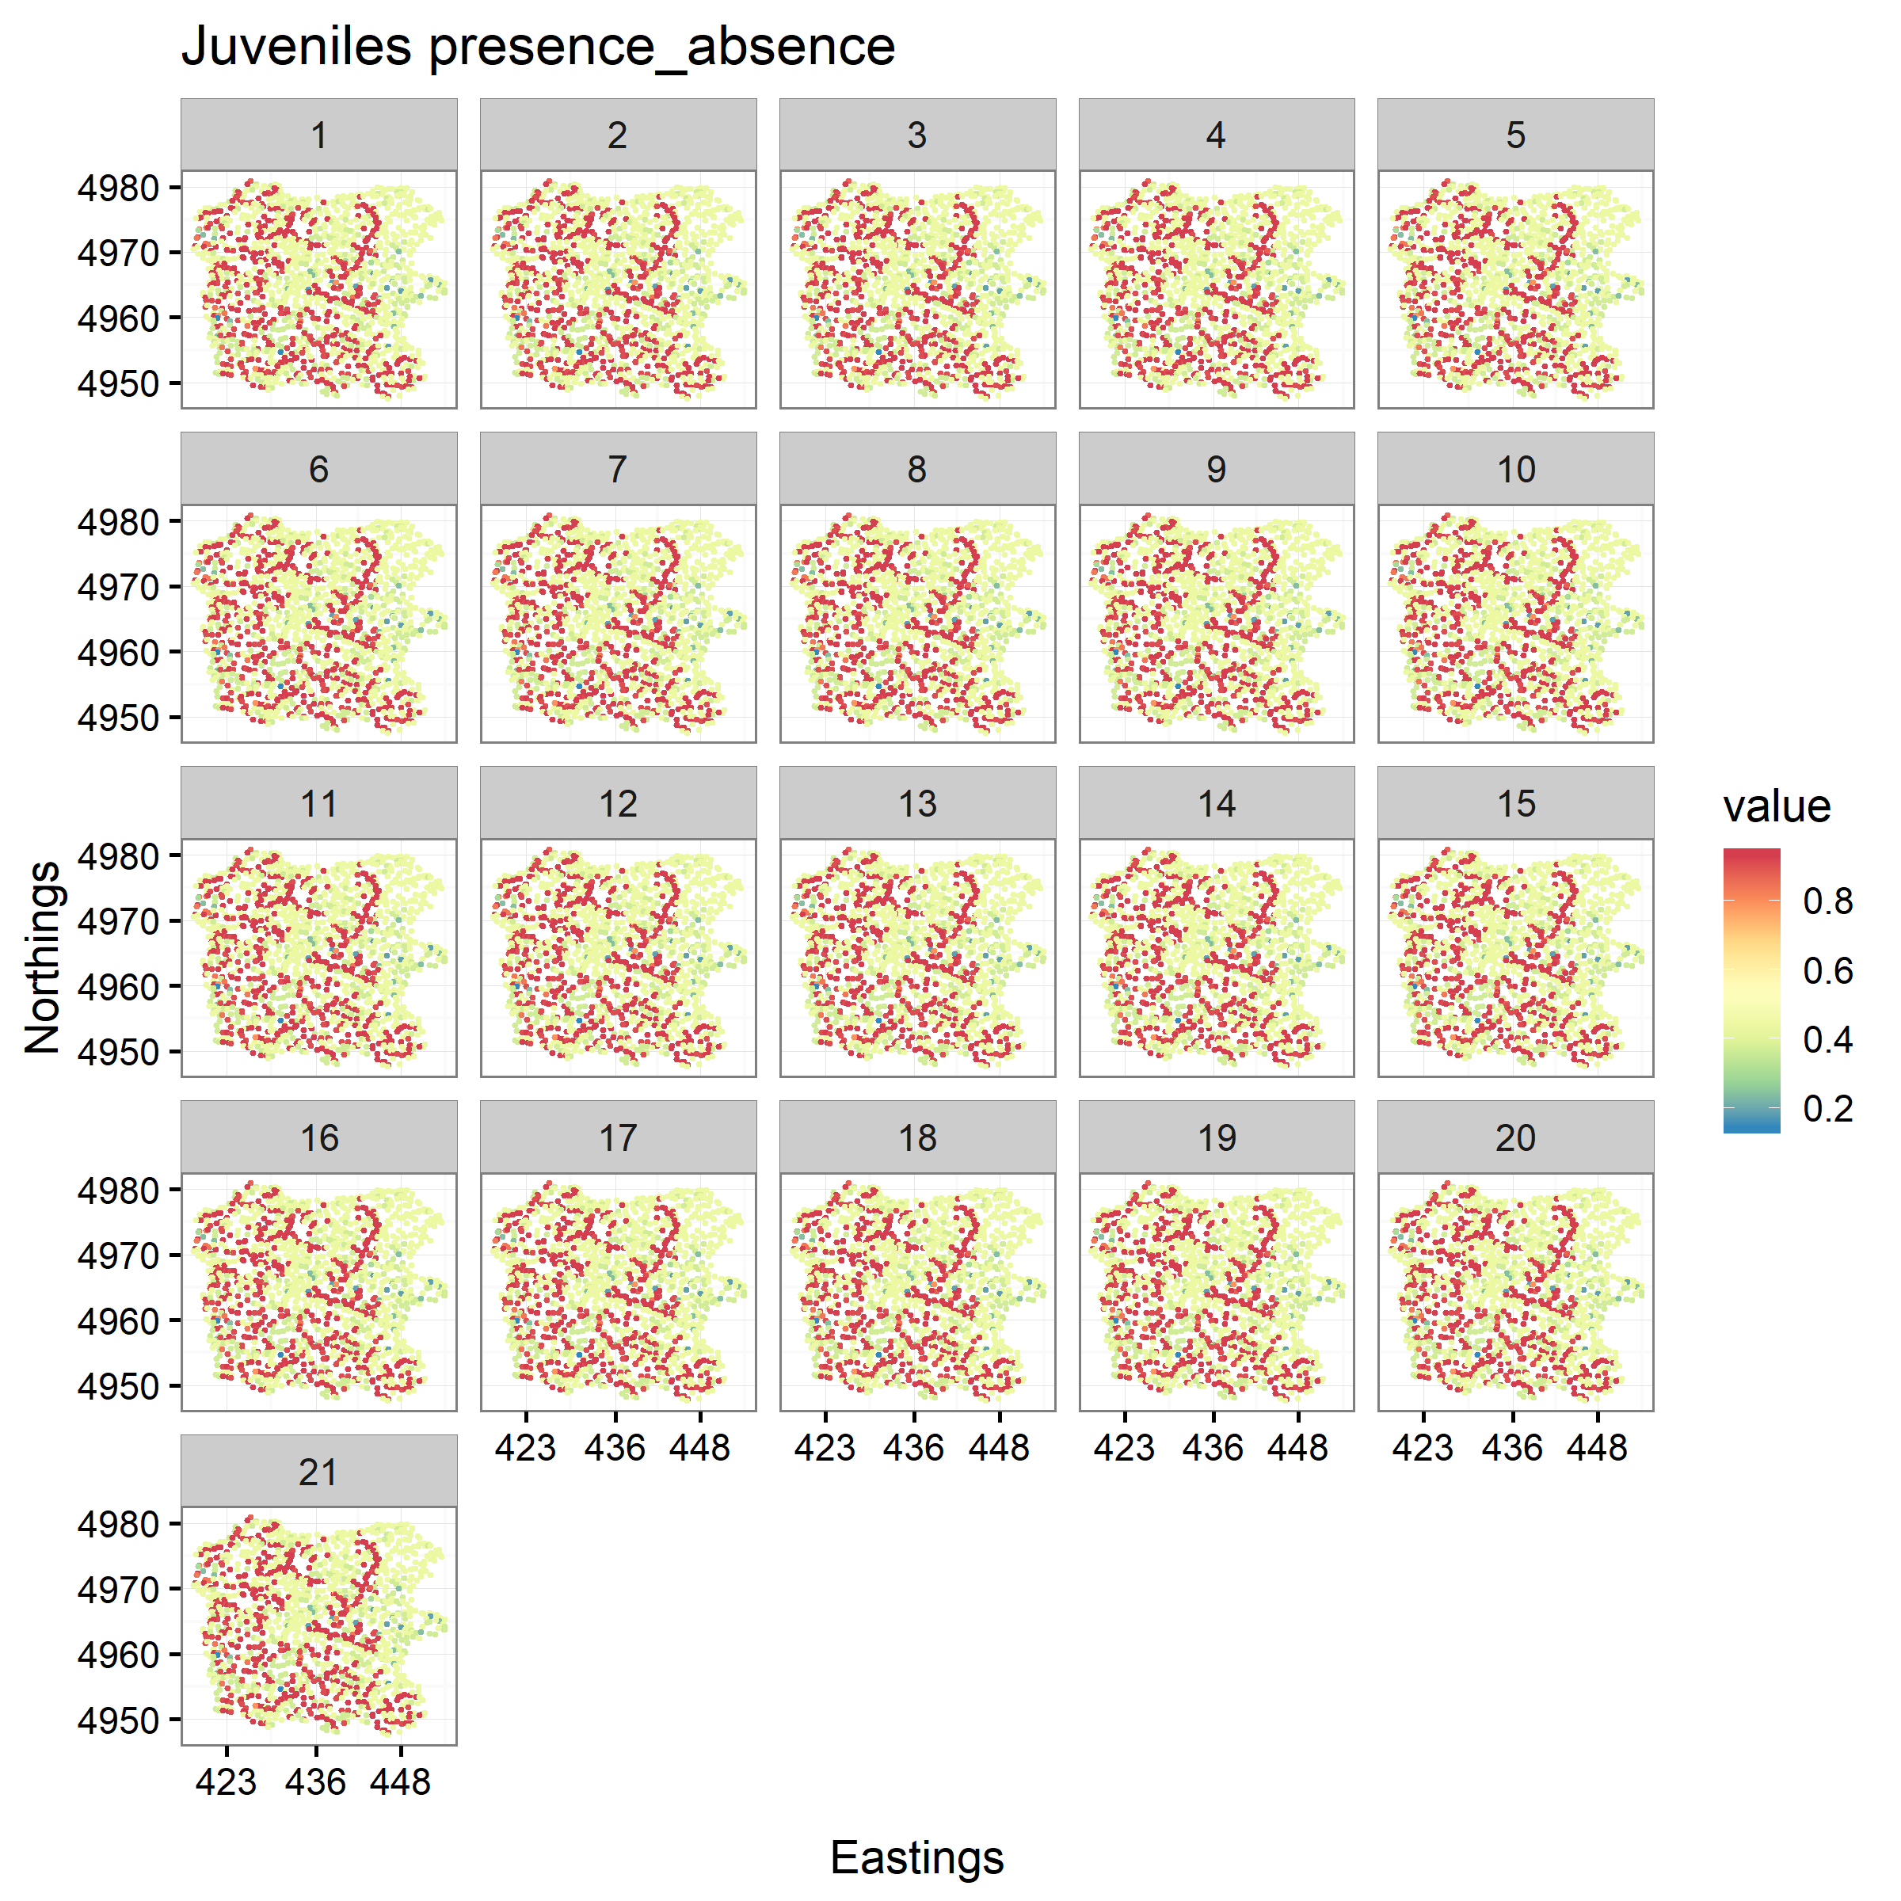
Habitat survey
Land cover categories
Juveniles zero-inflated probability
Juveniles zero-inflated probability

Slide 18
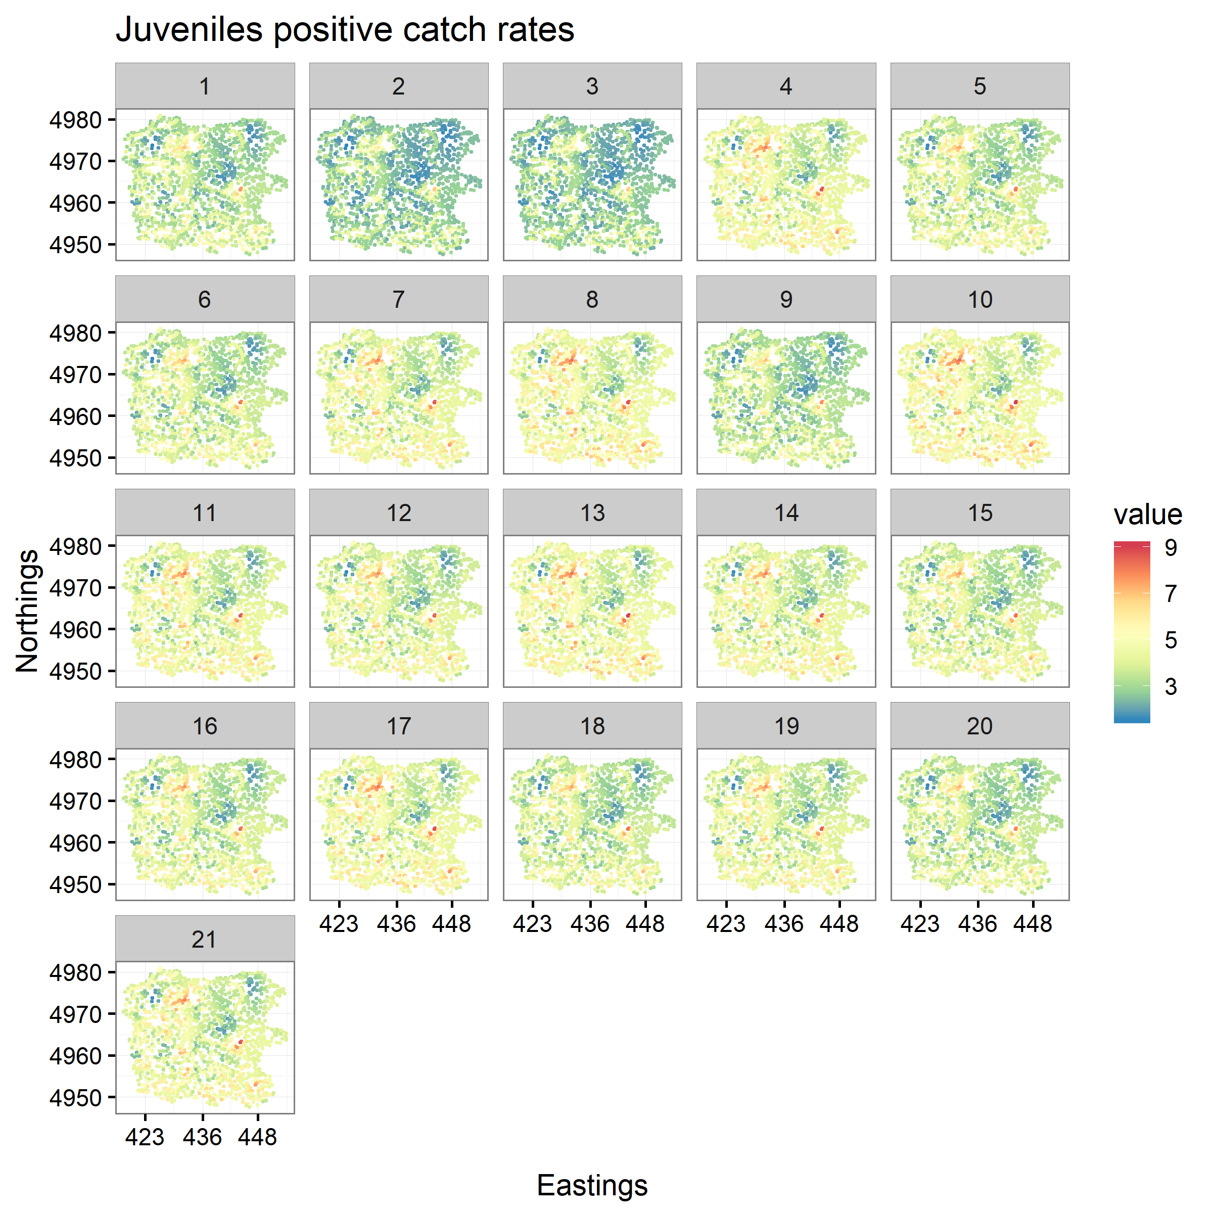
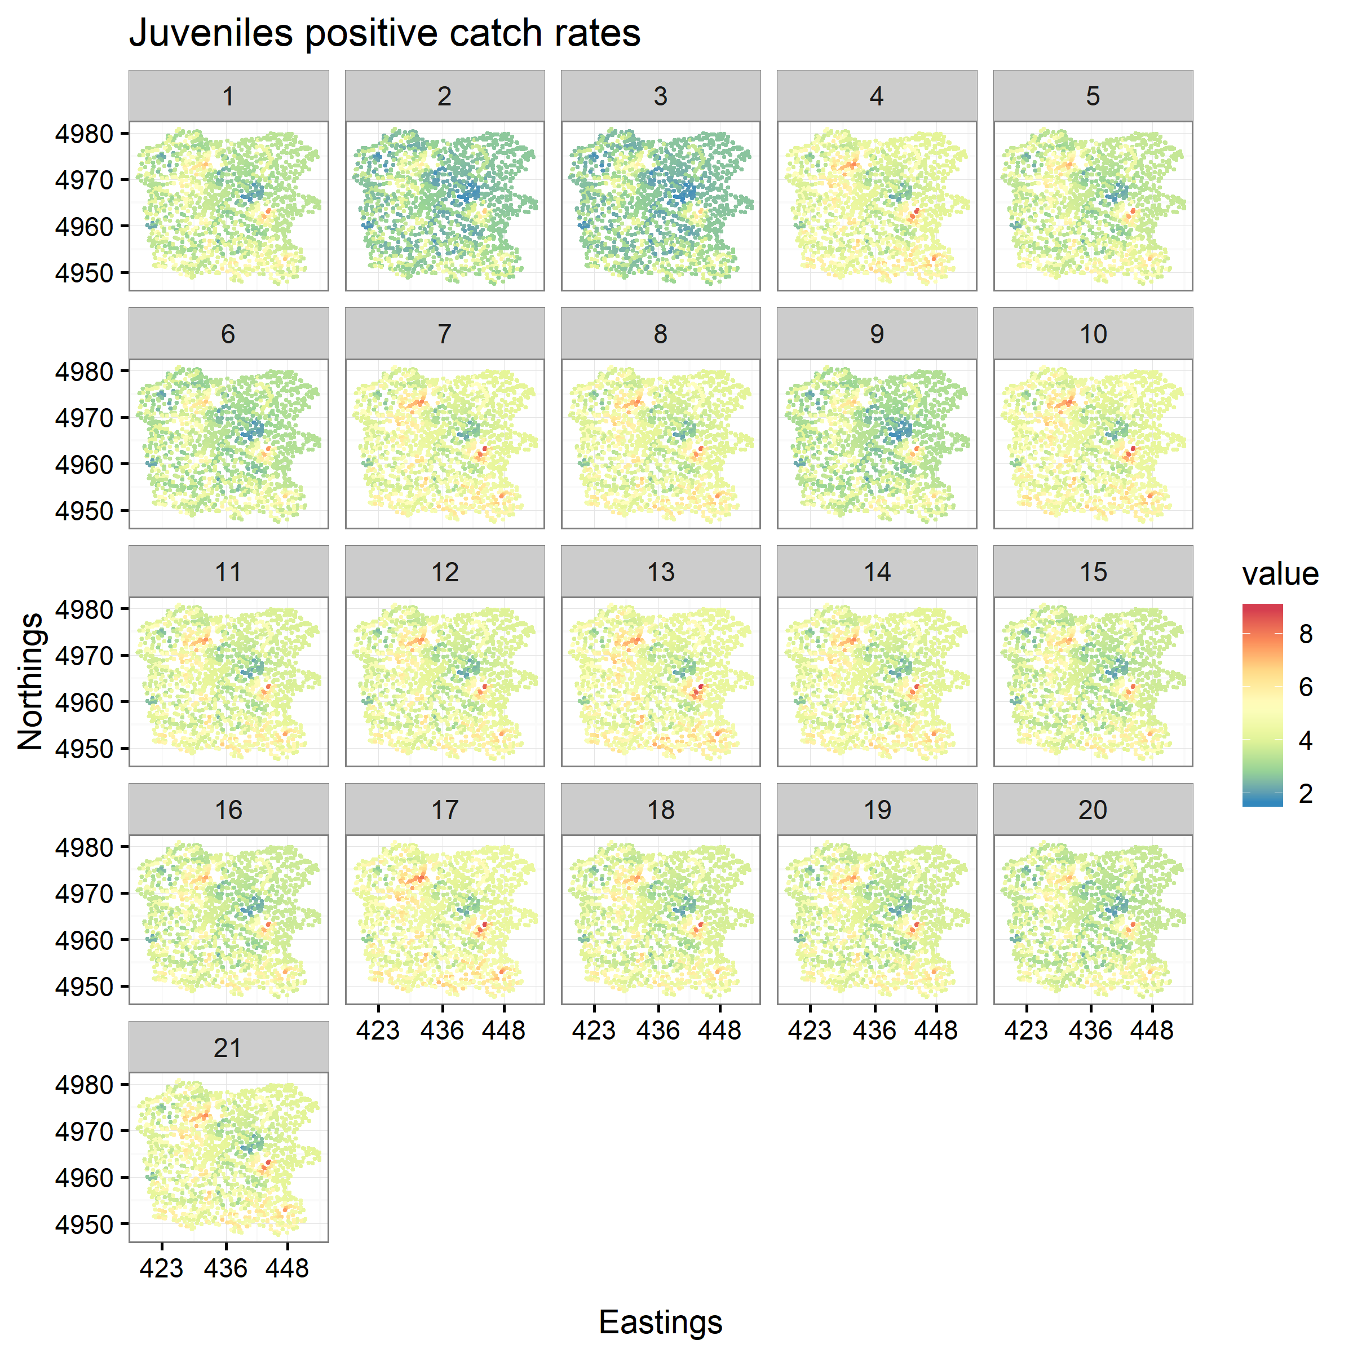
Habitat survey
Land cover categories
Juveniles abundance-density
Juveniles abundance-density
Juveniles zero-inflated probability
Juveniles zero-inflated probability

Slide 19
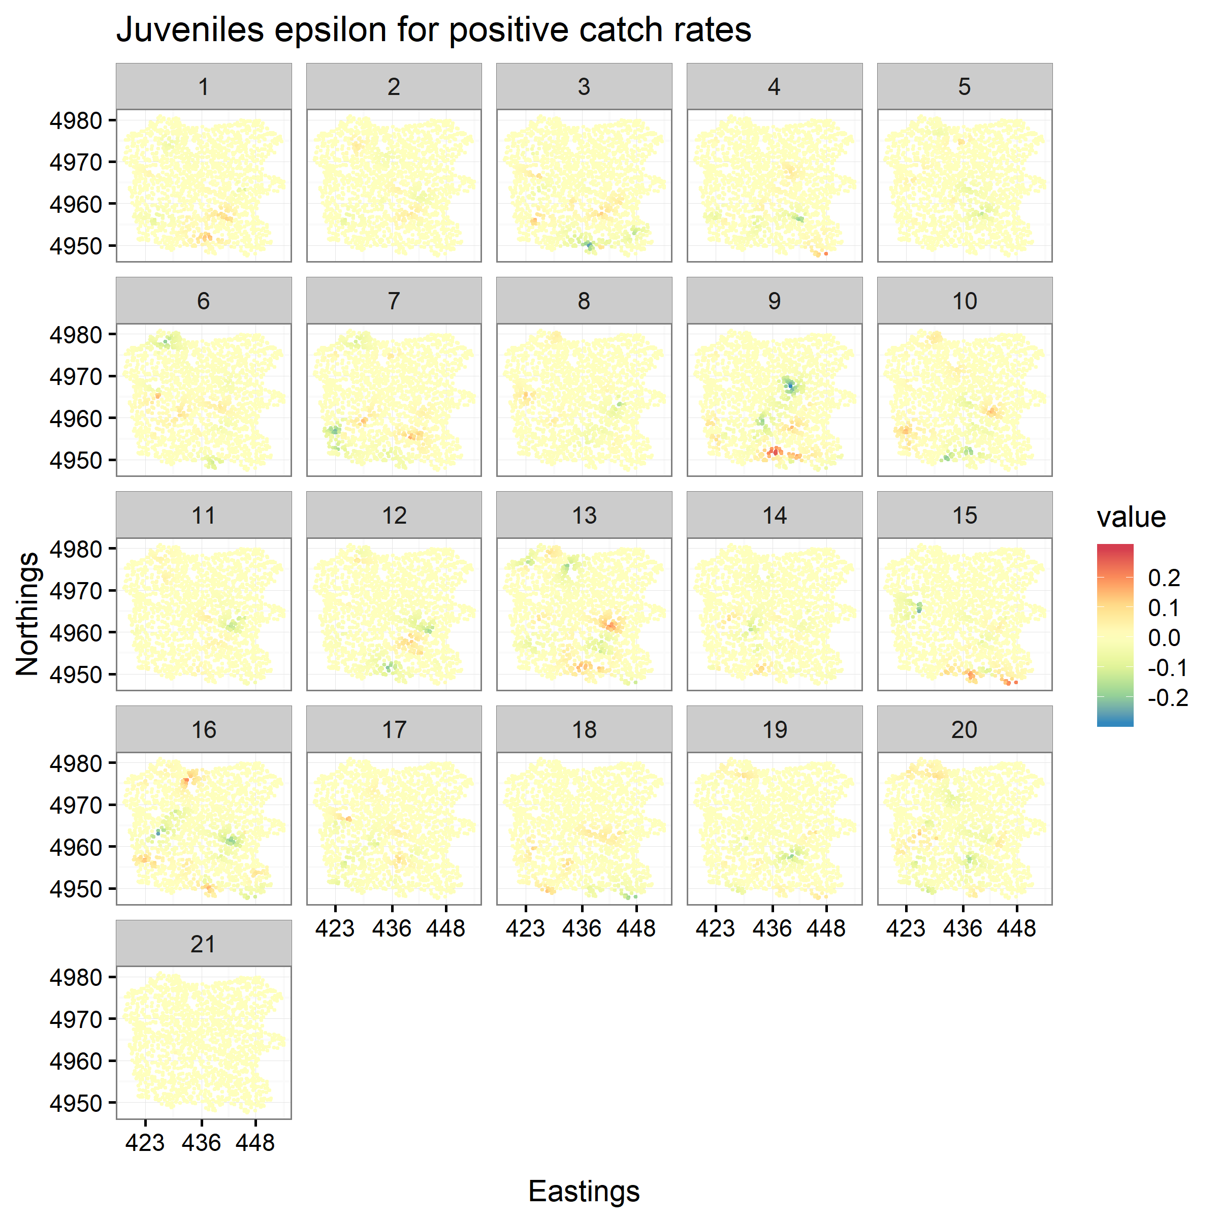
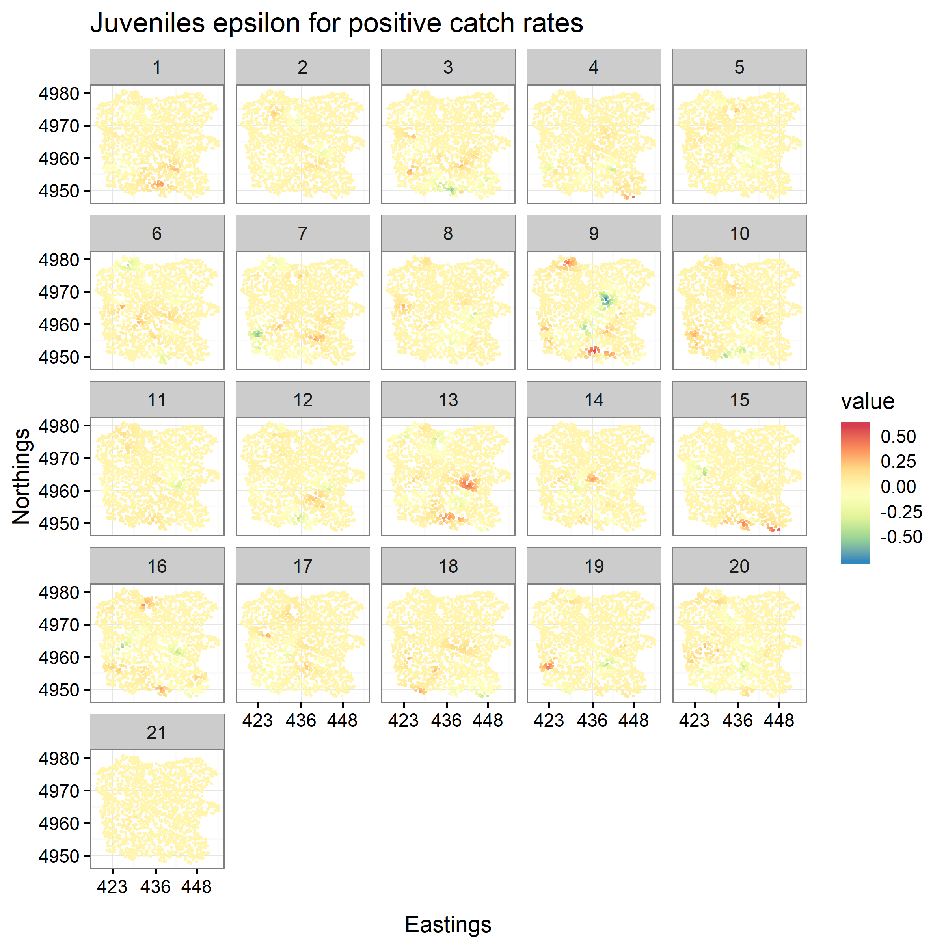
Habitat survey
Land cover categories
Juveniles spatiotemporal variation in abundance-density
Juveniles spatiotemporal variation in abundance-density

Slide 20
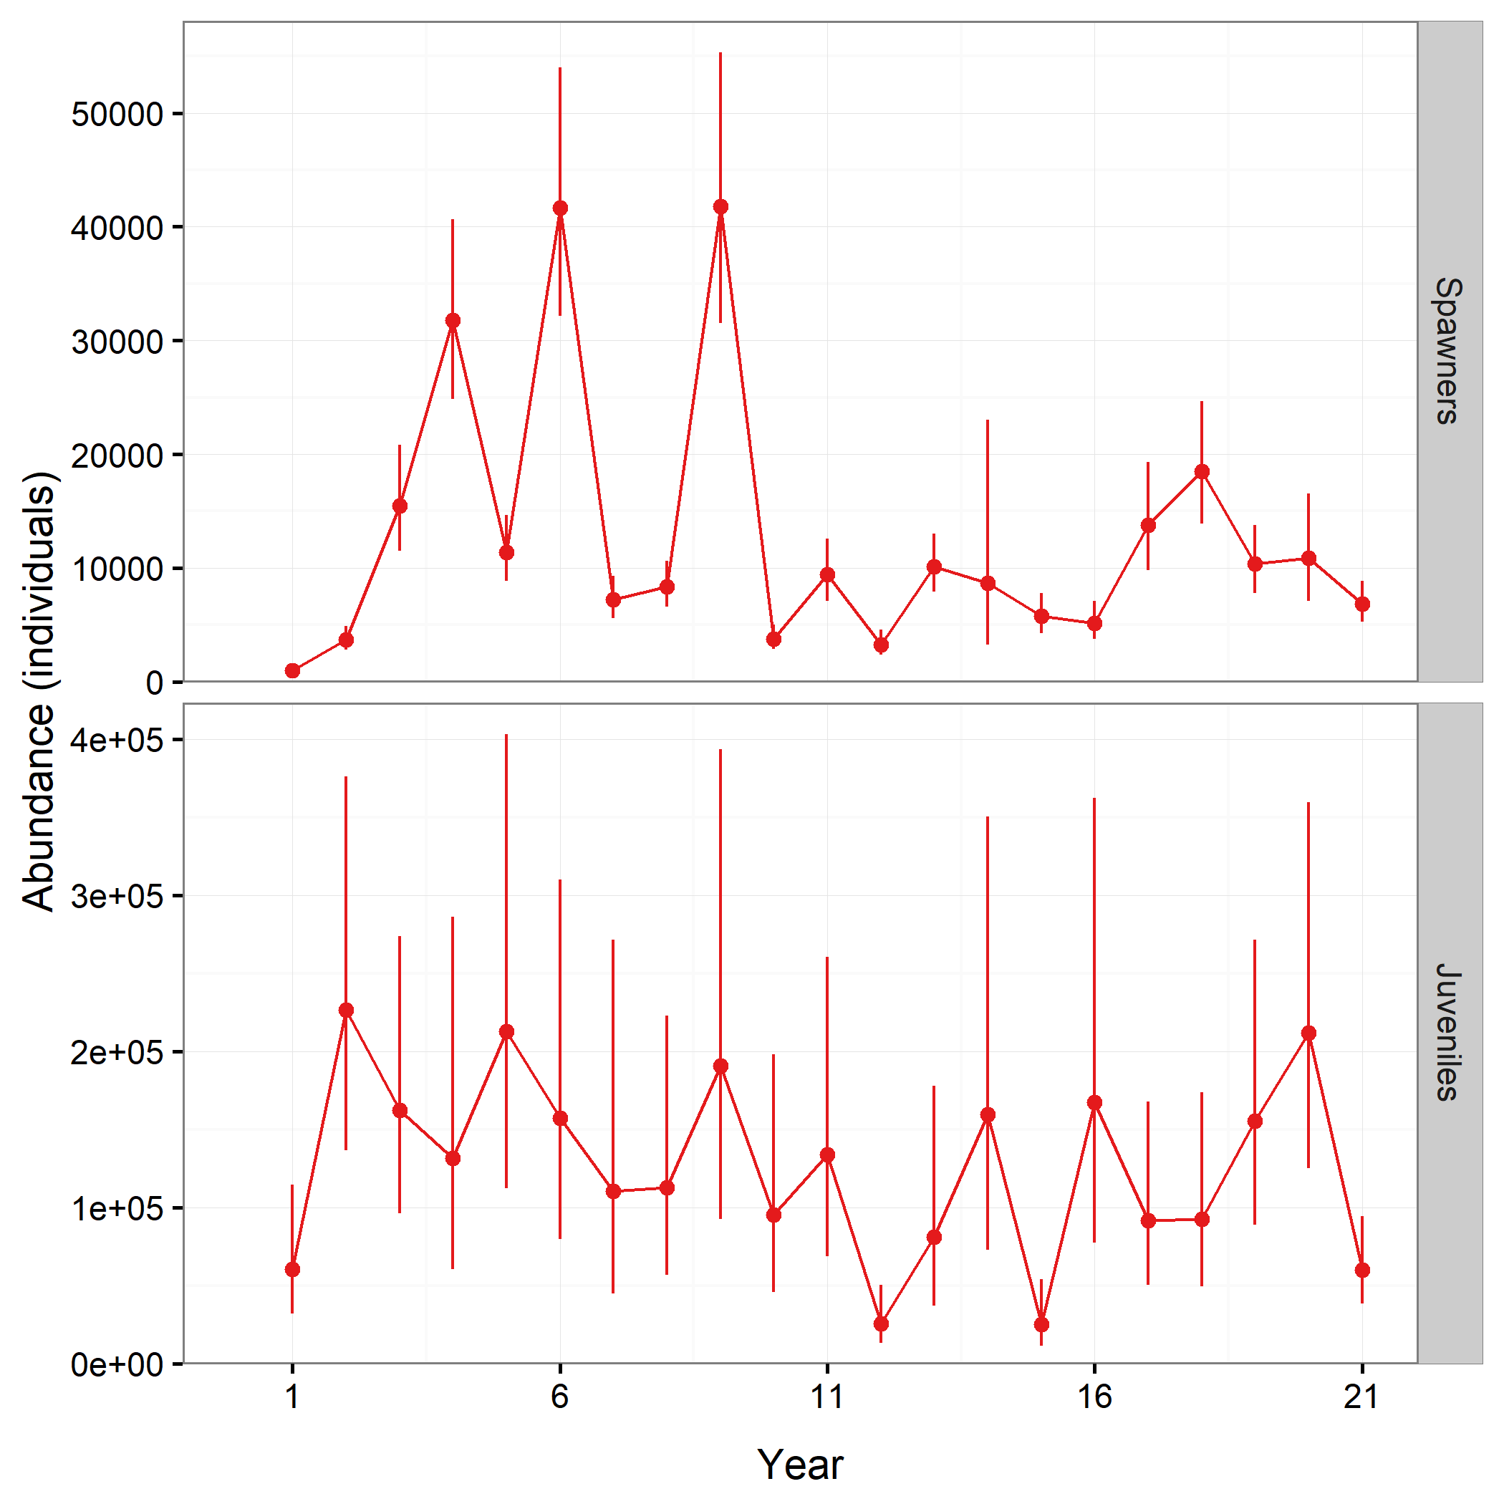
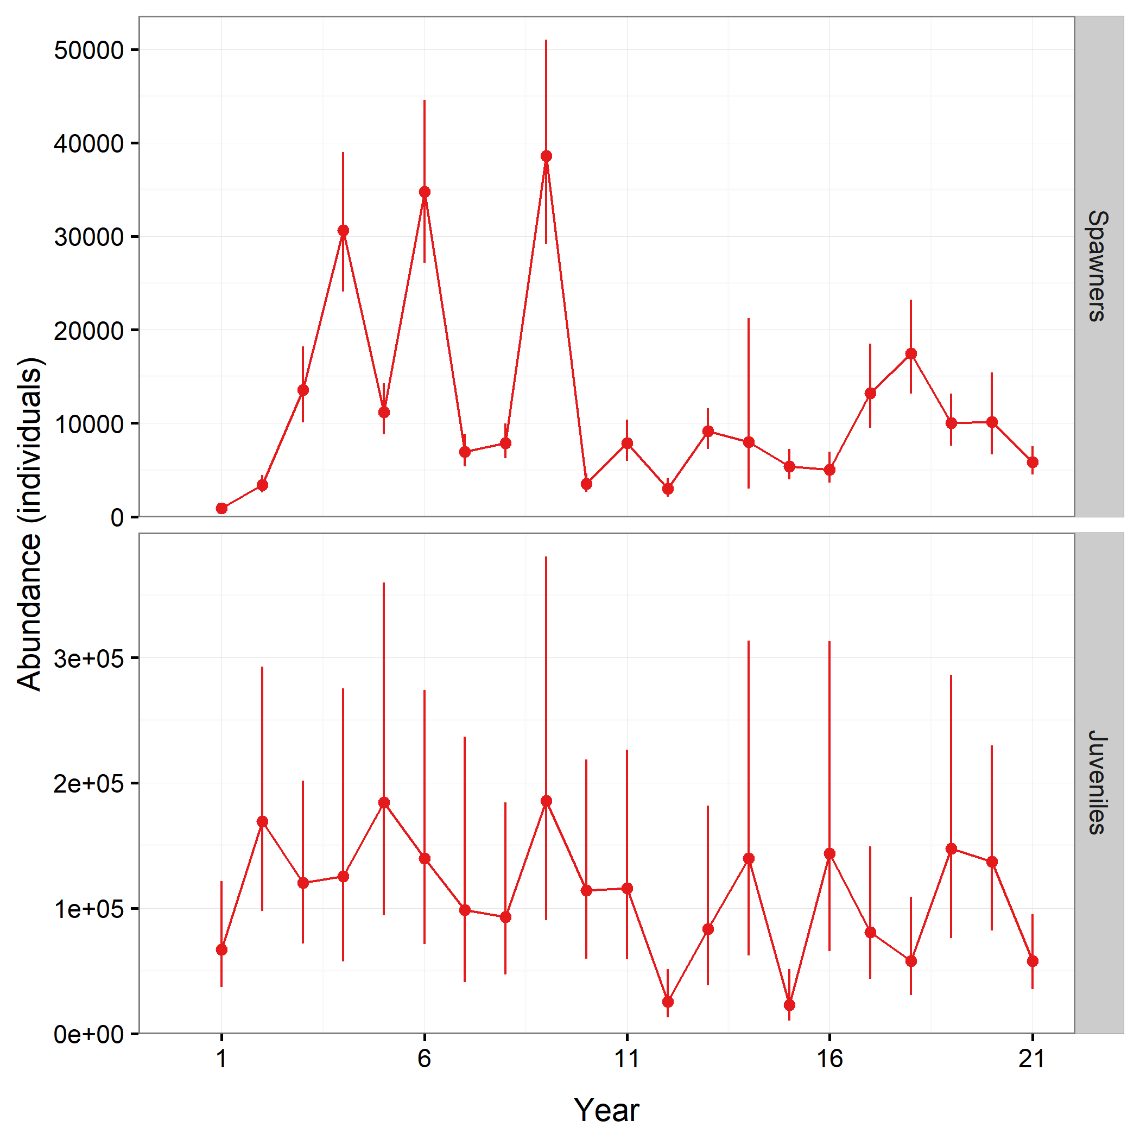
Habitat survey
Land cover categories

Slide 21
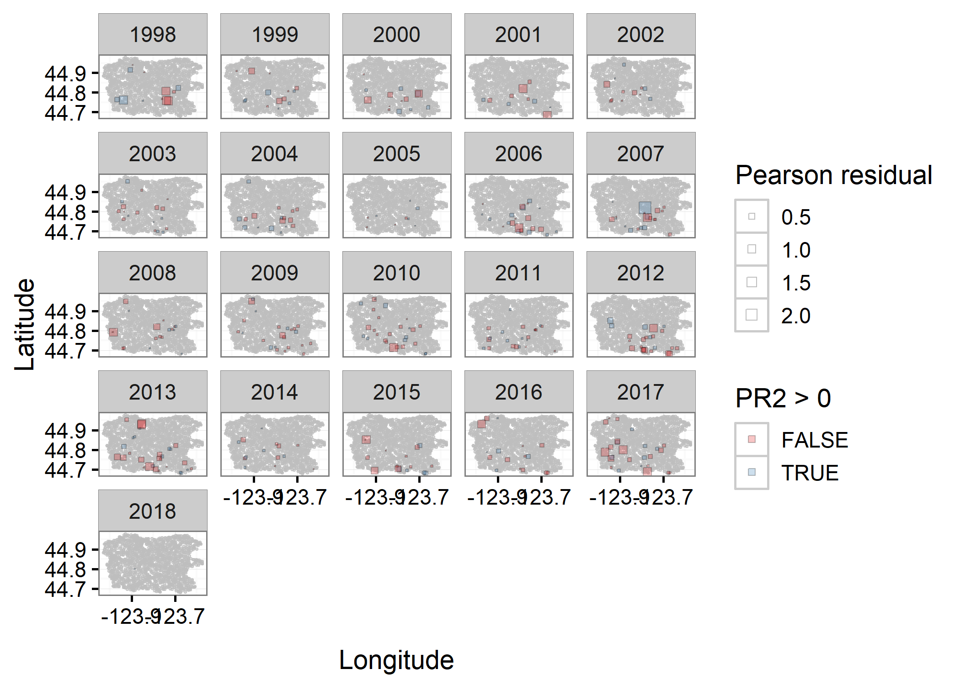
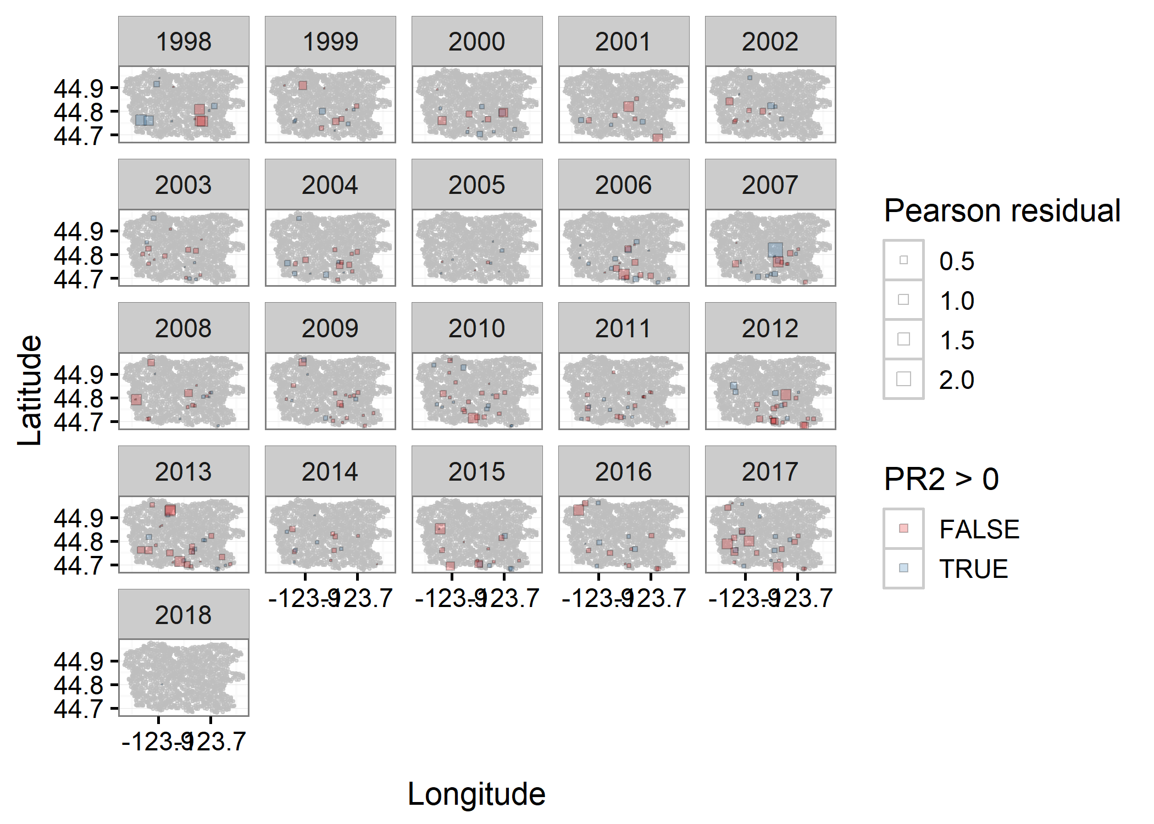
Habitat survey
Land cover categories

Slide 22
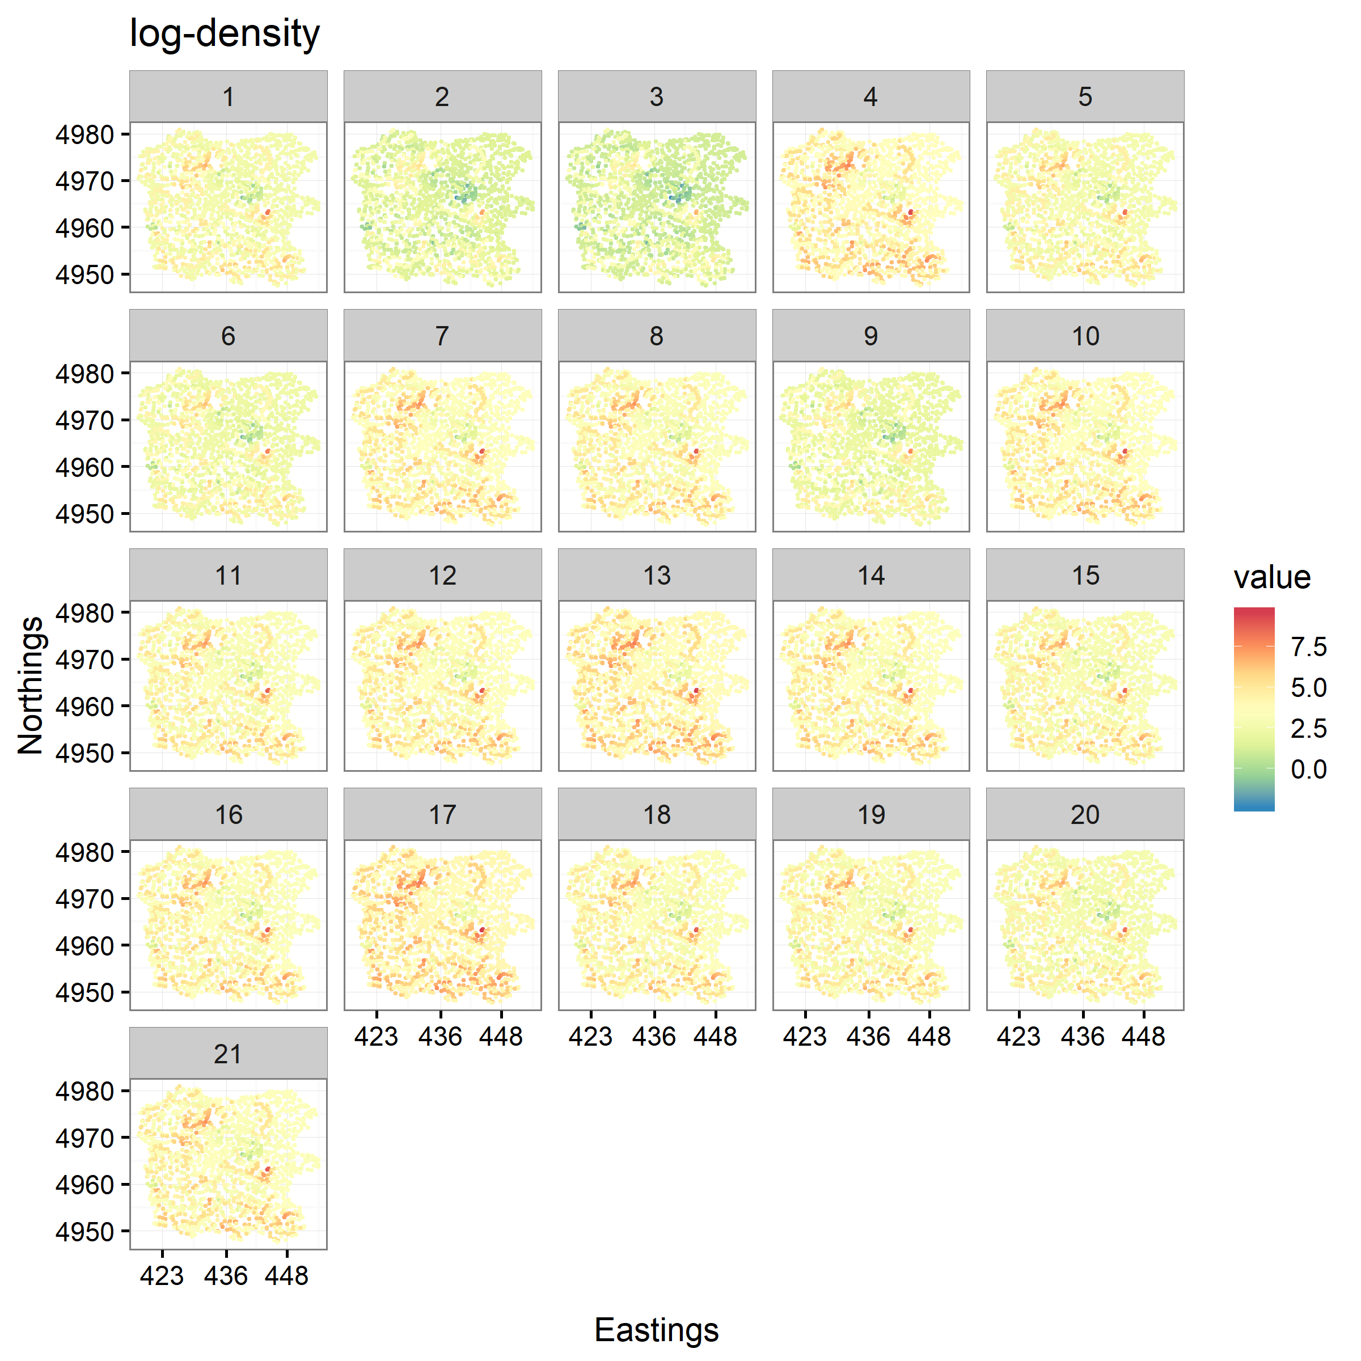
Multivariate
Univariate, juveniles
Land cover categories

Slide 23
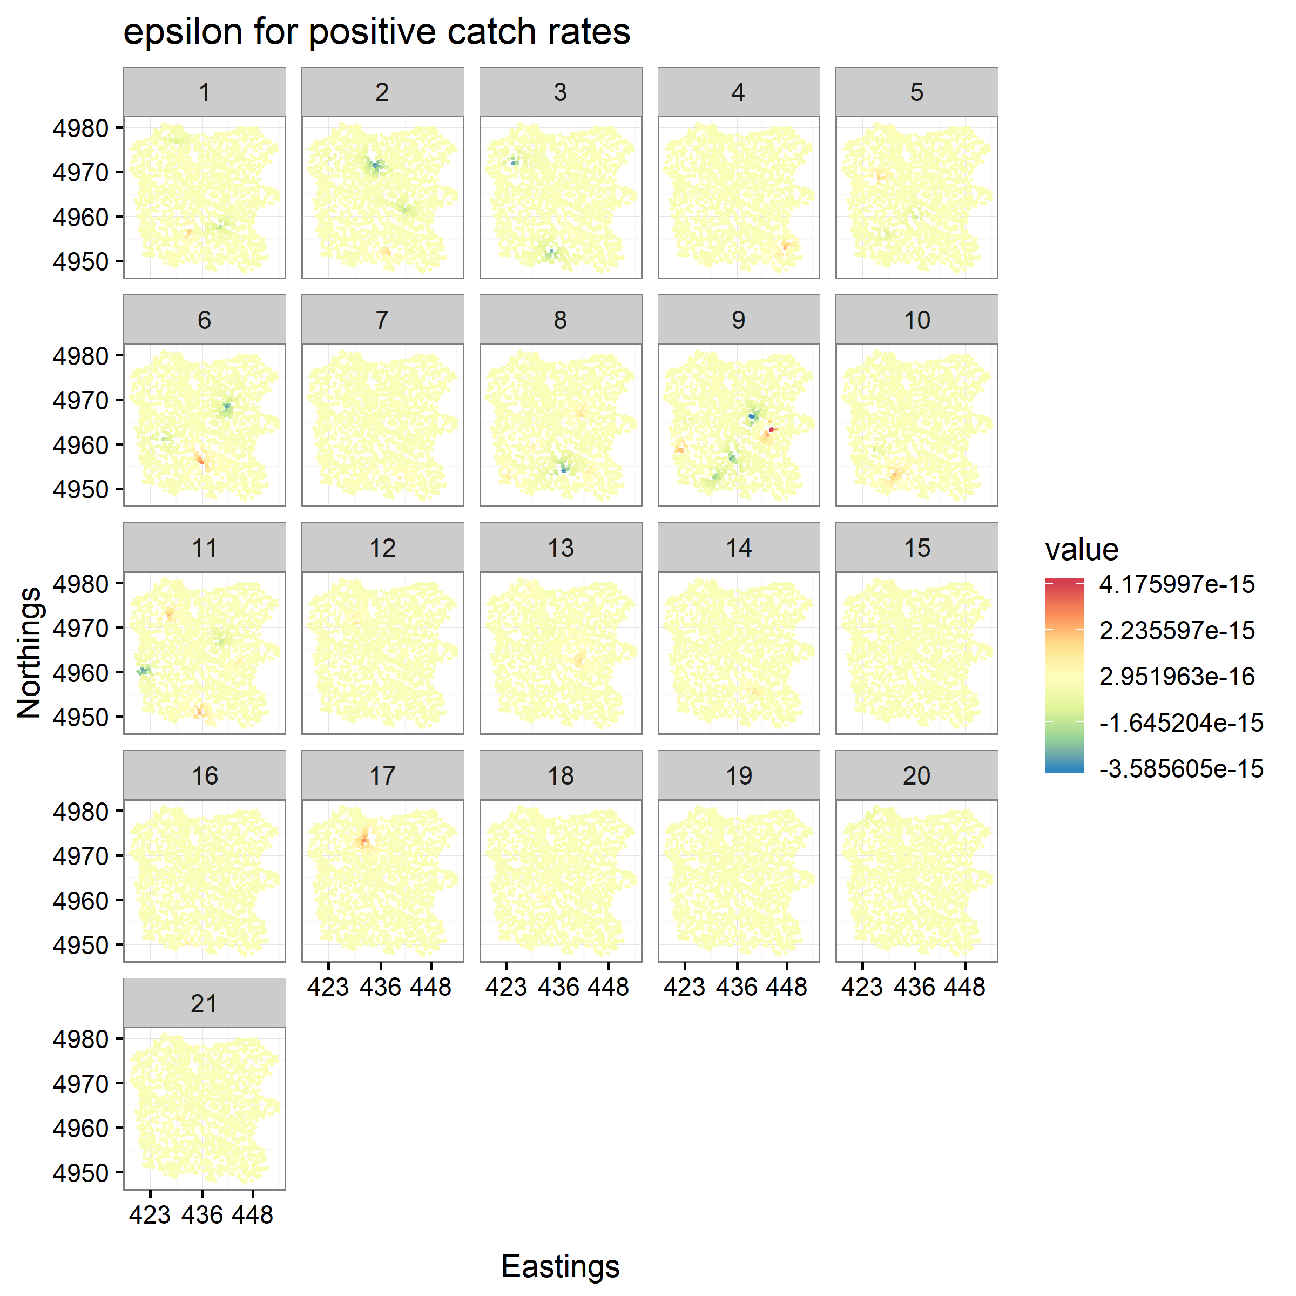
Multivariate
Univariate, juveniles
Land cover categories
Juveniles spatiotemporal variation in abundance-density
Juveniles spatiotemporal variation in abundance-density

Slide 24
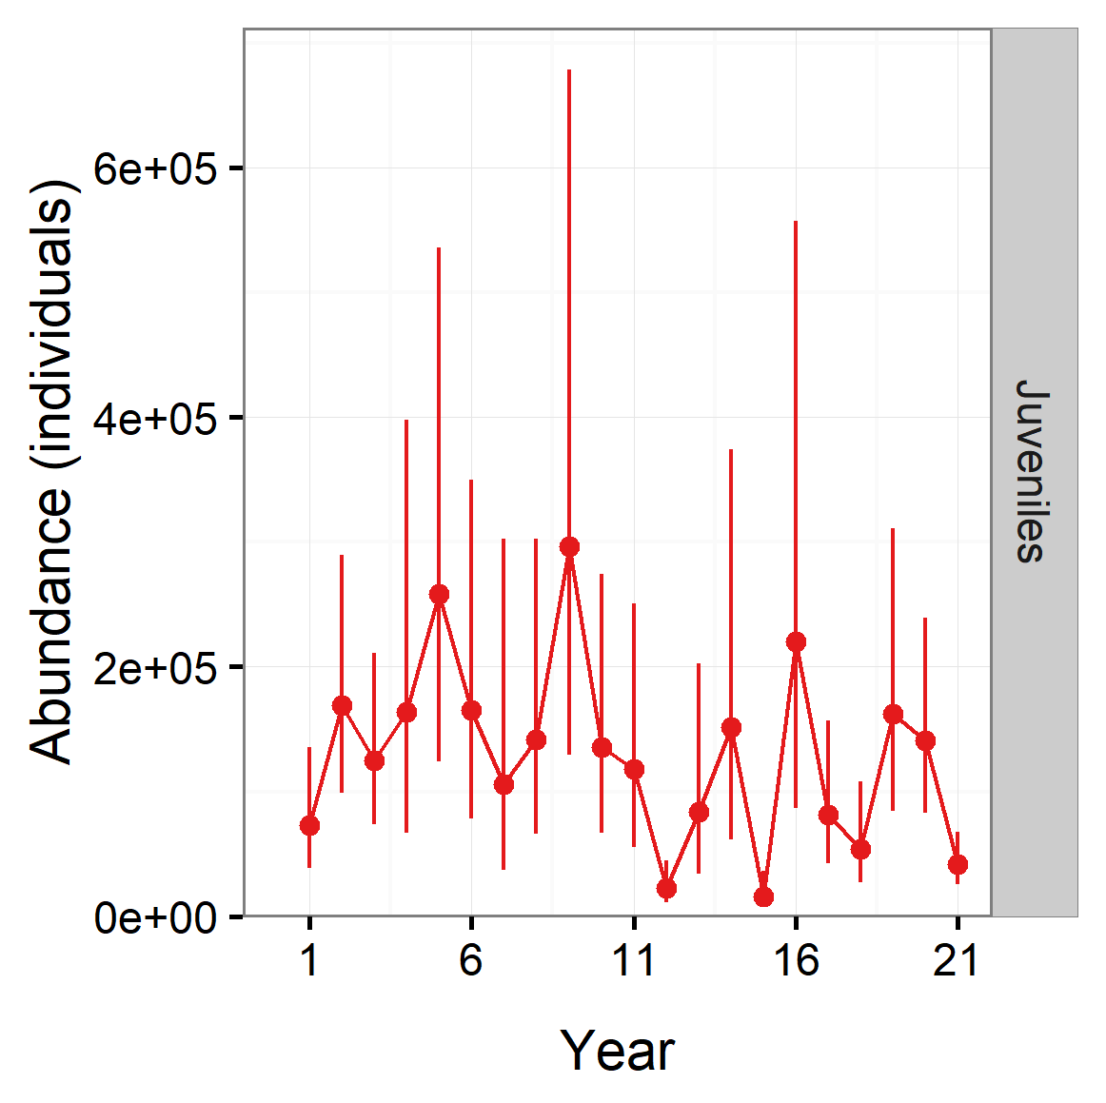
Multivariate
Univariate, juveniles
Land cover categories

Slide 25
Next steps
Work together to publish paper
1st example of VAST stream network model, and special case using a multivariate model
1st application of spatiotemporal models for OR coastal coho
Include cross-validation to assess prediction ability of spatiotemporal models

Slide 27
Process of running a model with VAST
Make decisions about model structure
Spatial model (e.g. Mesh, Grid, Stream_network, etc.)
Spatial and spatiotemporal effects
Temporal intercepts
Spatiotemporal variation
Observation model
Link function
Density and/or catchability covariates
Run model
Examine outputs

Slide 28
Process of running a model with VAST
Make decisions about model structure
Spatial model (e.g. Mesh, Grid, Stream_network)
Spatial and spatiotemporal effects
Temporal intercepts
Spatiotemporal variation
Observation model
Link function
Density and/or catchability covariates
Run model
Examine outputs
Required adjustments for stream network model

Slide 29
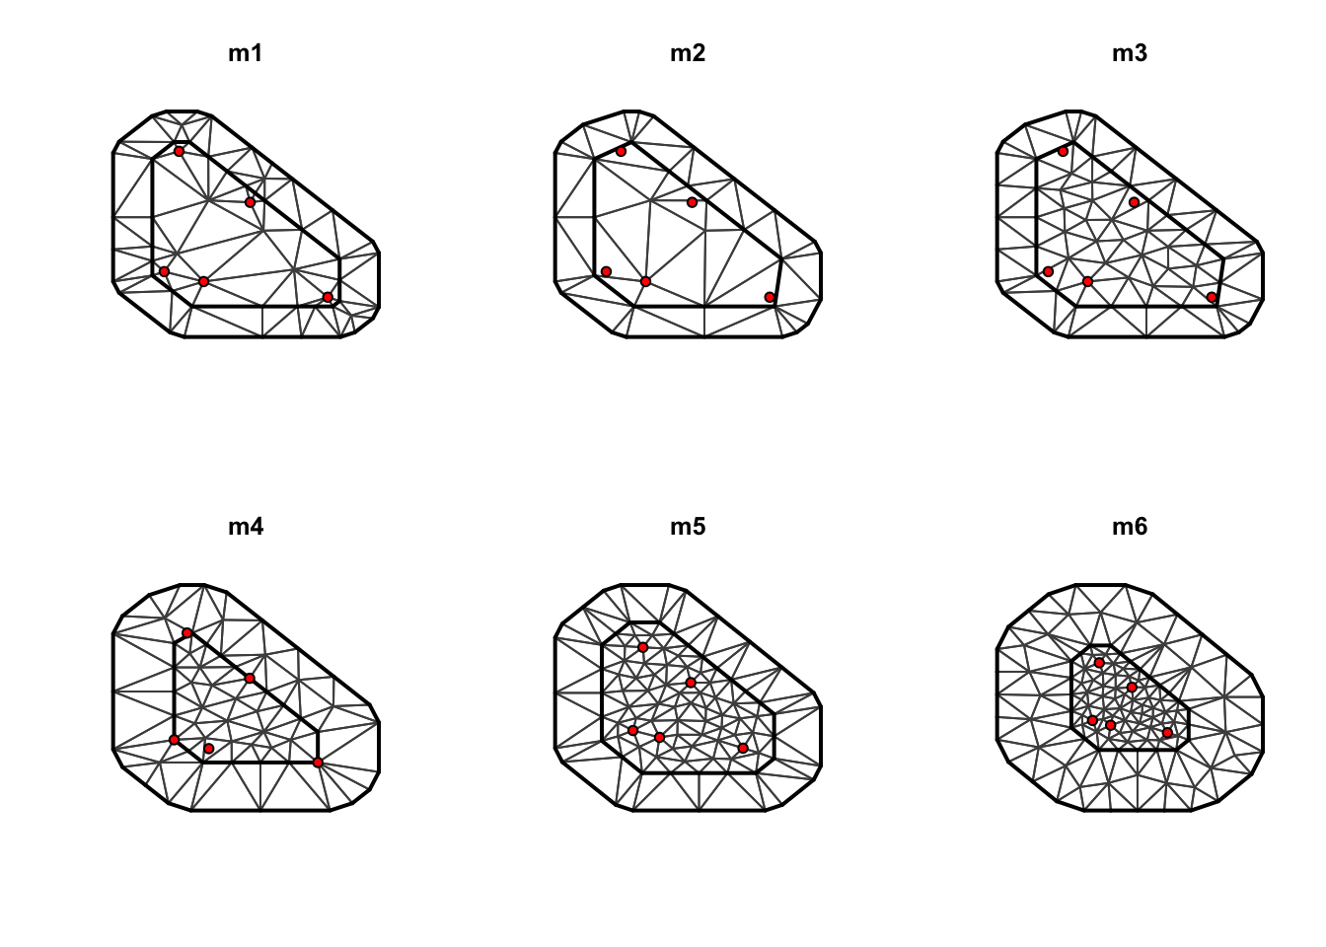
Spatial model: mesh vs. stream
User specified a number of knots (e.g. 1000).
K-means algorithm to identify the location of knots to minimize Euclidean distance between the location of data and location of nearest knot.
Stochastic partial differential equation (SPDE) approximation for the PDF for spatial and spatio-temporal variation using triangulated mesh where each knot is a vertex of a triangle.
Outputs from mesh can be used to calculate the inverse covariance (precision) matrix for multivariate PDF for value of spatial variable at each vertex.

Slide 30
Spatial model: mesh vs. stream
Number of knots in network depends on the number of stream segments and branching points.
No need for K-means algorithm, SPDE approximation, or triangulated mesh to identify the location of knots because they are already defined by the stream network.
Estimates from network nodes can be used to calculate the precision matrix for multivariate PDF for the value of spatial variable at each network node.

Slide 31
Specific updates for stream spatial model
Replace any calls to the K-means algorithm, SPDE approximation, or triangulated mesh calculation with input locations of network nodes
Network
Parent | Child | Area (km^2) | Lat | Lon
0 | 1 | Inf | 20.0 | 40.0
1 | 2 | 0.50 | 20.1 | 40.1
2 | 3 | 1.02 | 20.2 | 39.9
Observations
Child | Year | Density (numbers/km) | Lat | Lon | Category
2 | 2000 | 5 | 20.1 | 40.1 | Spawners
3 | 2015 | 10 | 20.2 | 39.9 | Spawners
3 | 2015 | 30 | 20.2 | 39.9 | Juveniles

Slide 32
Correlation between network nodes
Gaussian random fields
Correlation between location s and location s+h for spatial and spatio-temporal terms is approximated following a Matern function based on Euclidean distance
Function of geometric anisotropy (directional dependence), decorrelation distance, and a Matern smoothness parameter.
Ornstein-Uhlenbeck (OU) process
Correlation between upstream child node s and downstream parent node s_{parent} for spatial and spatio-temporal terms is a based on stream distance and connectedness.
Function of stream distance between site and its downstream parent, decorrelation distance, variance conditional on value of its parent, and asymptotic variance for two far-apart sites.

Slide 33
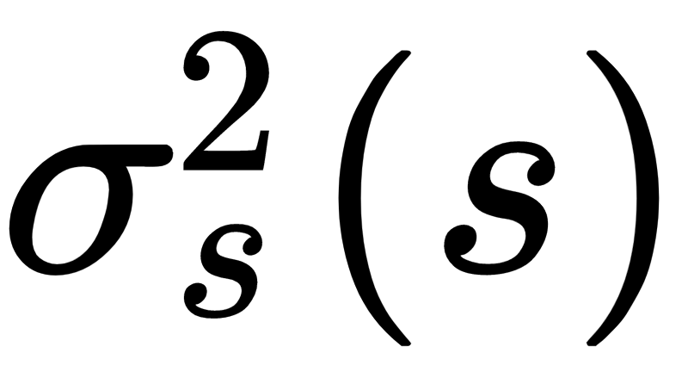
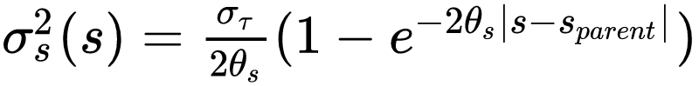
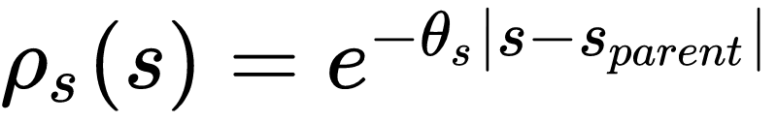
Ornstein-Uhlenbeck (OU) process
Child node correlated with the parent node as a function of distance:
Where is the variance for site s conditional on the value of parent s_{parent}:
The expected correlation between points in the network:
asymptotic variance for two sites that are far apart
exponential rate of decorrelation between child and parent nodes
distance between parent and child nodes

Slide 34
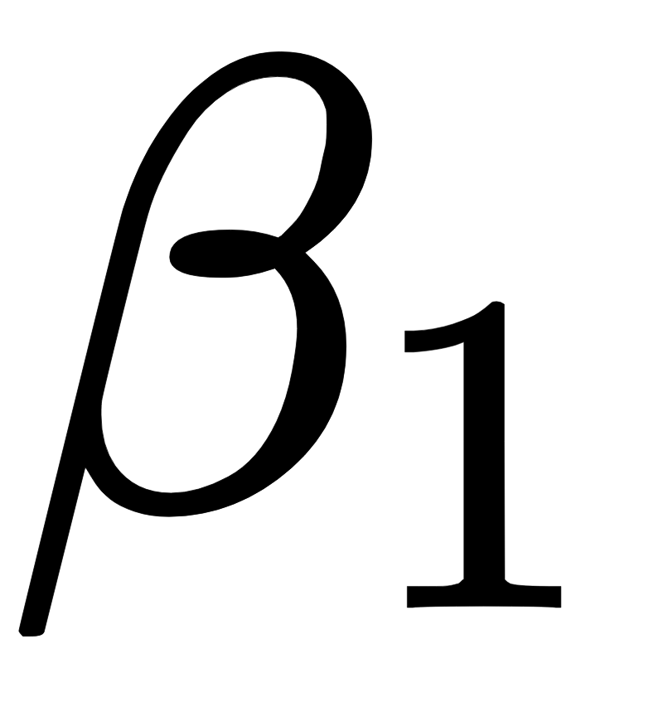
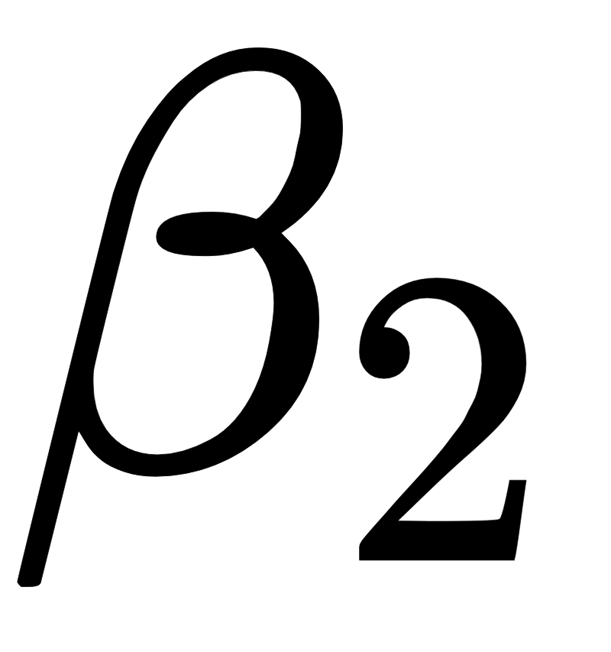
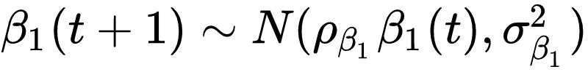
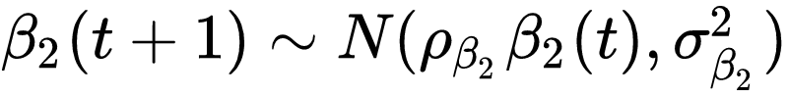
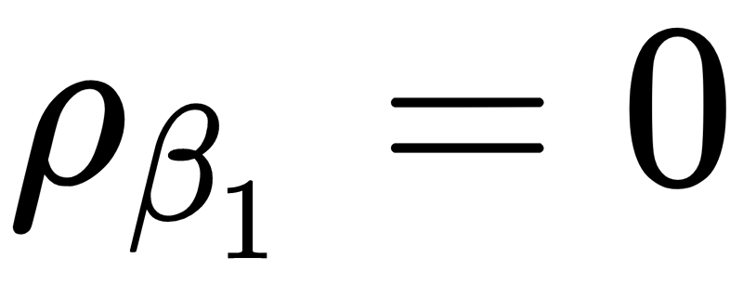
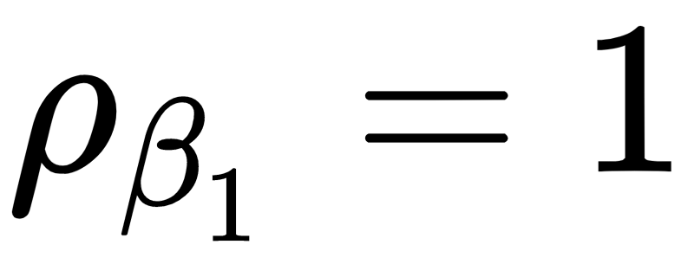
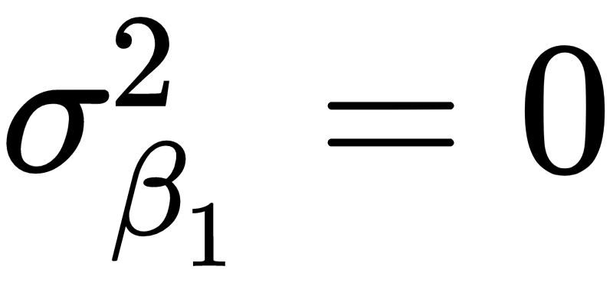
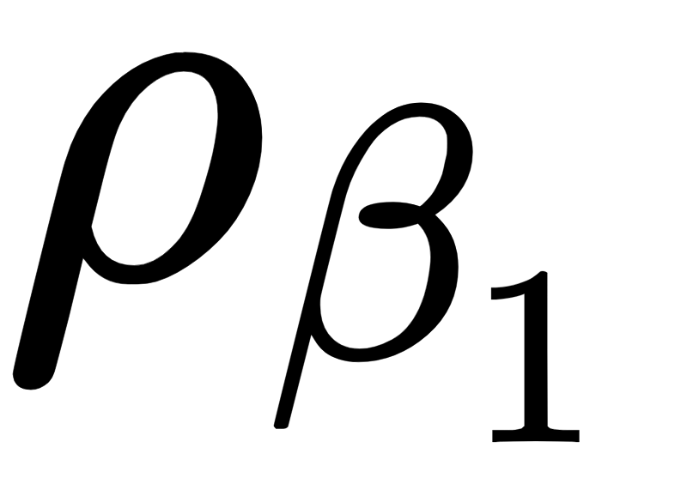
Temporal structure on intercepts
By default, VAST estimates temporal intercepts on encounter probability ( ) and positive catch rates ( ) as fixed effects, but can specify temporal structure:
Independent among years:
Random walk:
Constant intercept: and (i.e. constant for all t)
Autoregressive: estimated as fixed effect

Slide 35
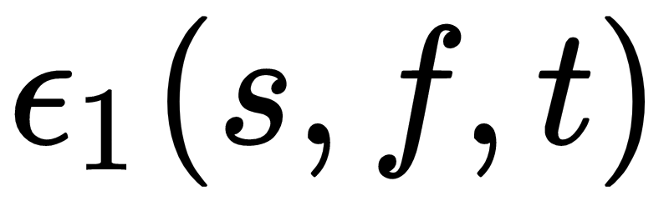
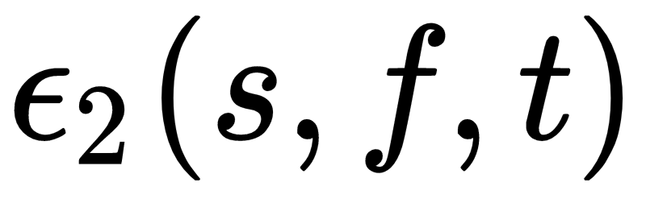
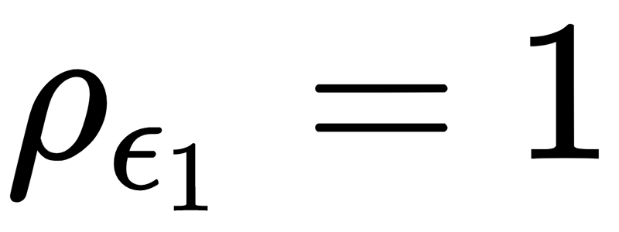
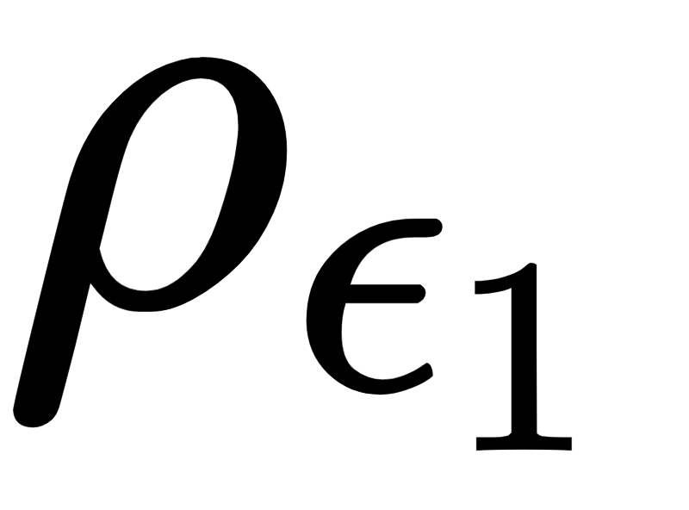
Temporal structure on spatiotemporal variation
By default, each spatiotemporal random effect and is independent among years, but other settings can specify the following structure:
Random walk:
Autoregressive: estimated as fixed effect

Slide 36
Model convergence and adjustments
Models including juveniles were more difficult to fit, requiring examination of the estimates from preliminary runs that did not calculate standard errors
Determine which parameters were estimated close to zero (typically variance parameters for the juvenile category), and then fix those to zero
Occasionally needed to adjust starting values for the decorrelation rate
Make sure all parameters are identifiable and none of the parameters are estimated close to a bound

